Slide 1


DISTROKIDS
LET US BE THE SOLUTION
PRESENTATION

Slide 2

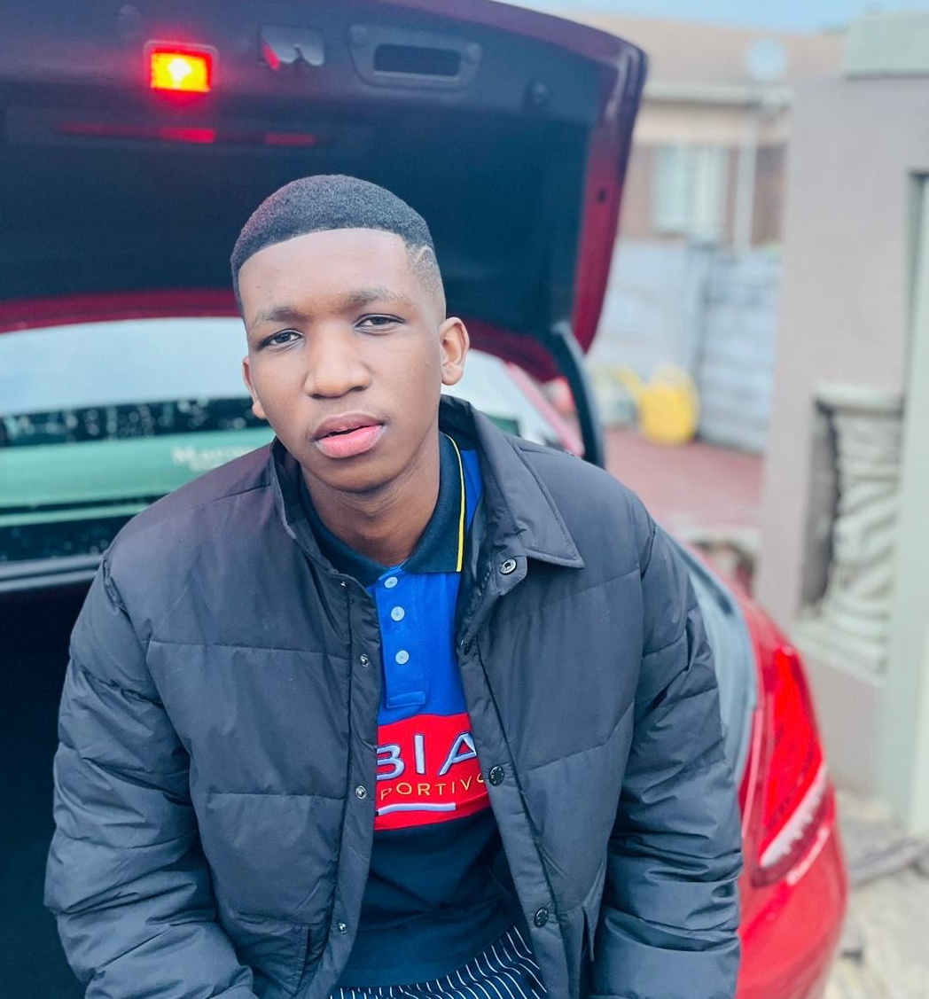
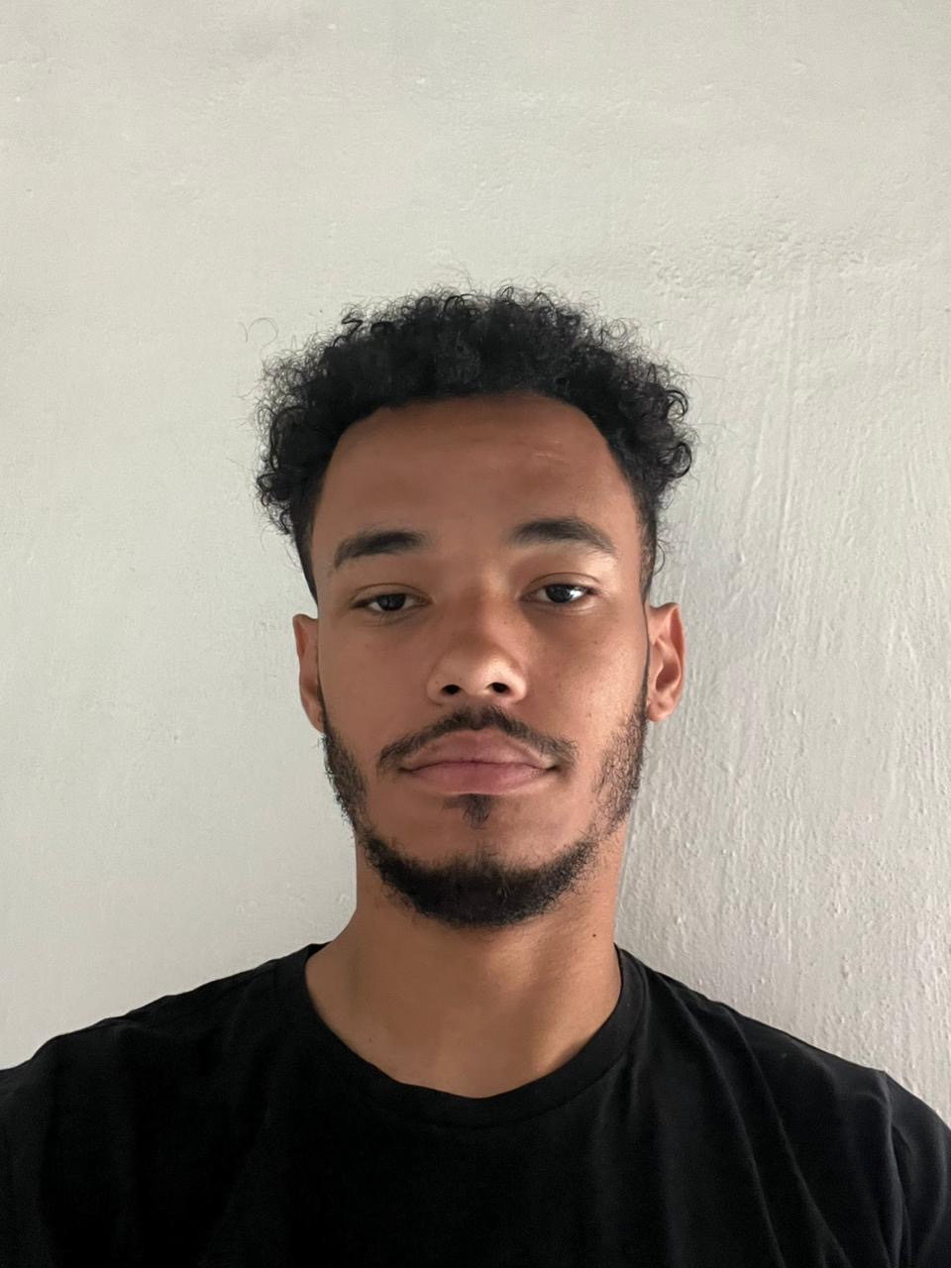
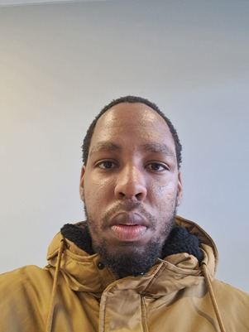

GROUP MEMBERS
Reatlegile Sibanda
Project Manager
&
Team Leader
Jordan Leafe
Software Developer Lead
Mokwena Menyatso
App and Web Coordinate
Andile Motshweni
Business Analyst

Slide 3
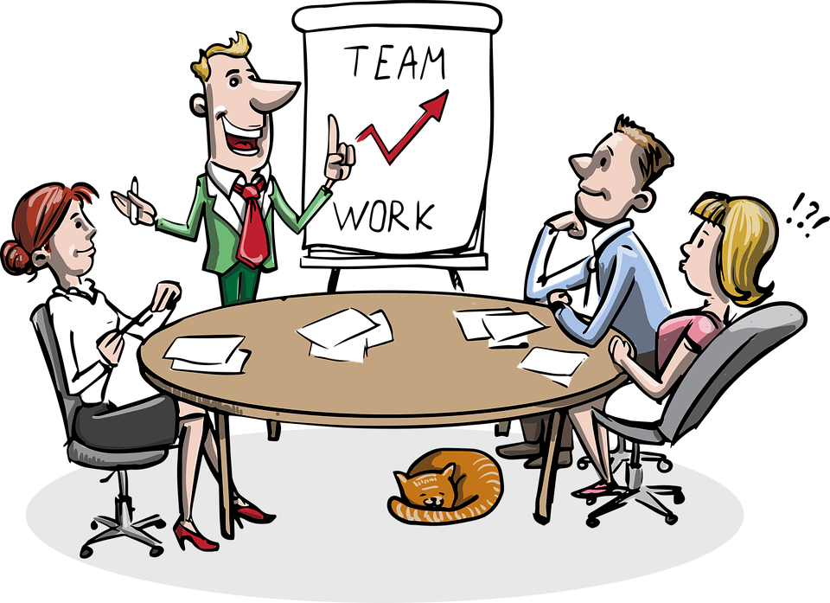
TABLE OF CONTENT
PROBLEM STATEMENT
BUSINESS SOLUTION
MILESTONE & DELIVERABLES
WORK BREAKDOWN STRUCTURE
RISK MANAGEMENT
TECHNICAL FEASIBILITY ISSUES
BUDGET
WEBSITE SOLUTION DOMAIN
APPLICATION SOLUTION DOMAIN
ARCHITECTURAL DESIGN HIGH-LEVEL
ADMINISTRATOR "MANAGER"
USER "CLIENT"
ARCHITECTURAL DESIGN LOW-LEVEL
USER INTERFACE "WEBSITE DESIGN"
USER INTERFACE "DESIGN APP"
ADMIN INTERACTIONS
DATABASE DESIGN

Slide 4

PROBLEM STATEMENT
There has been thorough research and analysis of the food ordering processes on college campuses, conducted collaboratively by our team and campus dining services. This investigation revealed a significant problem: the current ordering systems are inefficient and cumbersome. Additionally, both current and potential customers are not adequately informed about the diverse food options available from various vendors. Our findings highlighted the need for a streamlined, user-friendly platform that not only simplifies the ordering process but also provides comprehensive information about the available food items, including nutritional details, pricing, and vendor rating.

Slide 5

BUSINESS SOLUTION

Slide 6
OUR BUSINESS SOLUTION:
WEBSITE
APPLICATION
To address the first issue, we are designing a comprehensive website that not only streamlines the food ordering process but also provides detailed information about the various food items available from a nearby vendor. The website will feature intuitive navigation, detailed menus, nutritional information, pricing, and vendor ratings, ensuring that users are well-informed about their food choices.
To address the second issue, we are developing a mobile application that will enable users to create accounts and seamlessly order food from nearby campus vendor. This application will allow users to browse menus, customize their orders, make secure payments, and track their orders in real-time. The app aims to enhance the overall user experience by providing a convenient and efficient platform for food ordering on the go.

Slide 7

MILESTONE & DELIVERABLES

Slide 8
Milestones | Deliverables
Approval Document | Project proposal, scope document
Project Initiation | Project charter, stakeholder analysis, requirements specification document, feasibility report, initial risk assessment.
Requirement analysis | Problem domain, solution domain, class diagrams
Design and Prototyping | UI/UX mock-ups, app architecture and design specifications, working prototype, prototype test plan.
System Design | Logical architectural design, user interaction design, database design
Development Phases | Coding of website(user),application (user and admin) Alpha Version: Internal app testing, test reports, updated risk assessment.
Launch Preparation | Final app version, ASO materials, launch marketing plan, training sessions, customer support setup.
App Launch and Post-Launch | Launch event, customer feedback report, update roadmap
Documentation | All documentation done
Growth and Scaling | New feature updates, user feedback survey on features.

Slide 9
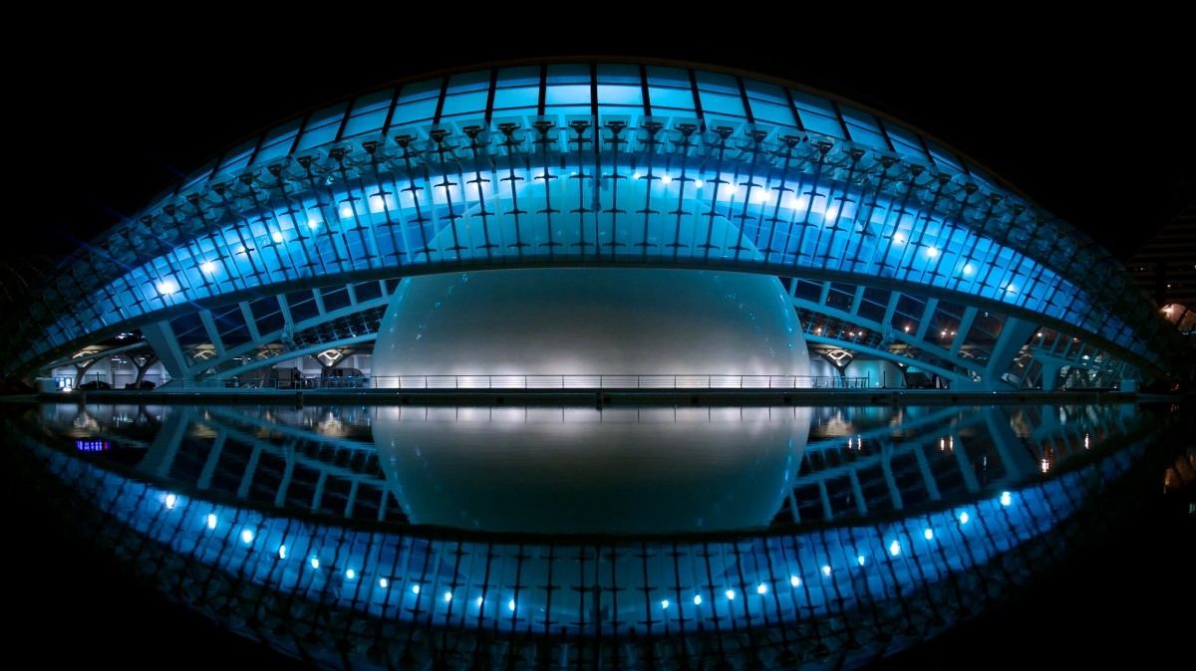
WORK BREAKDOWN STRUCTURE

Slide 10
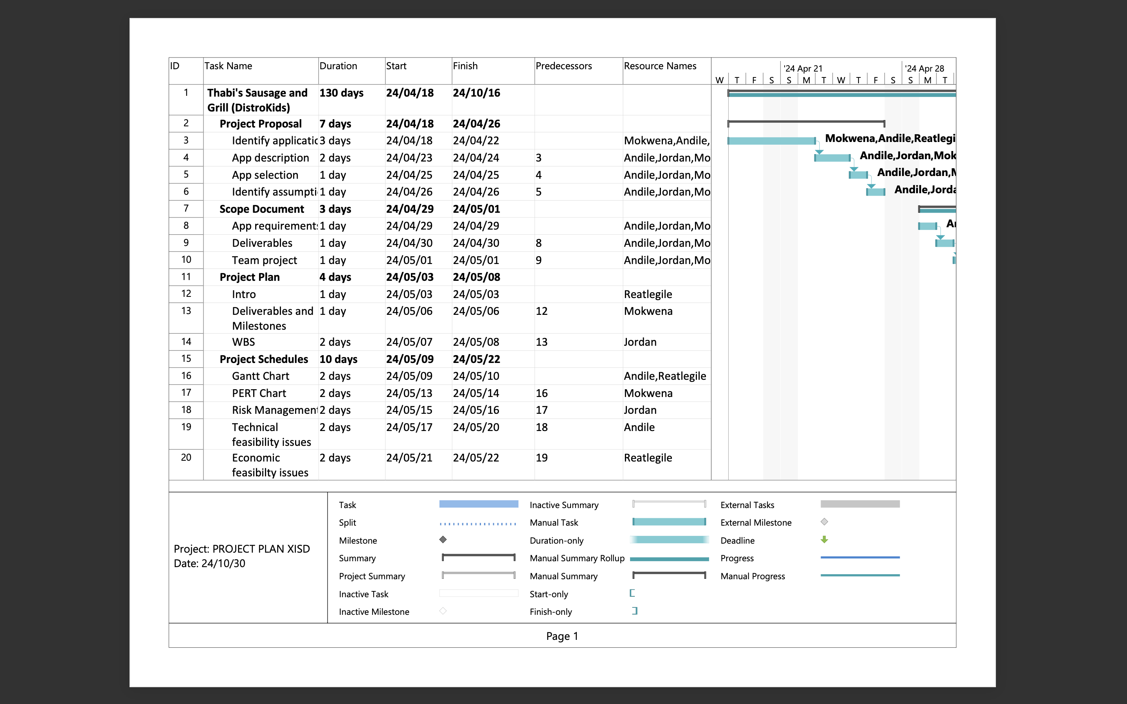
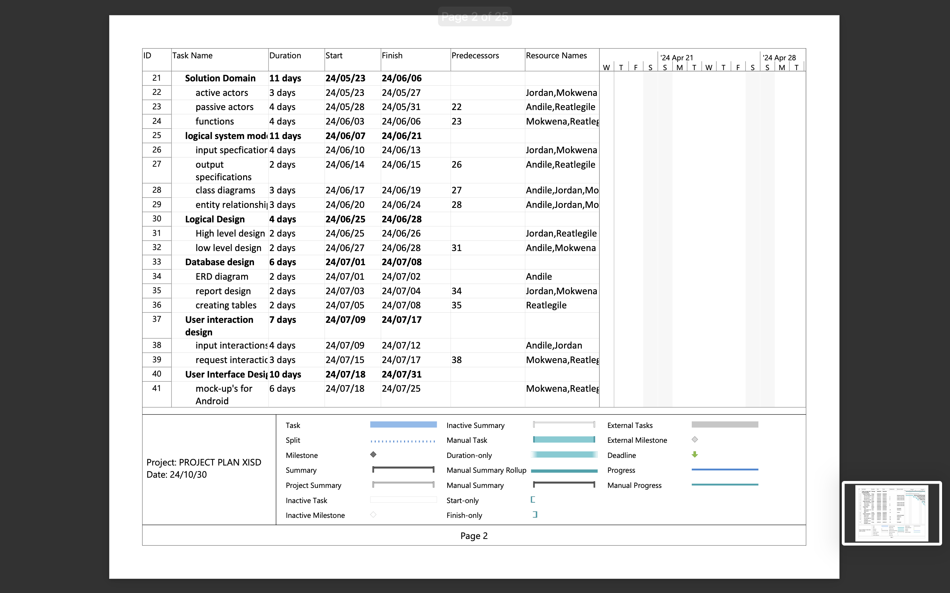

Slide 11
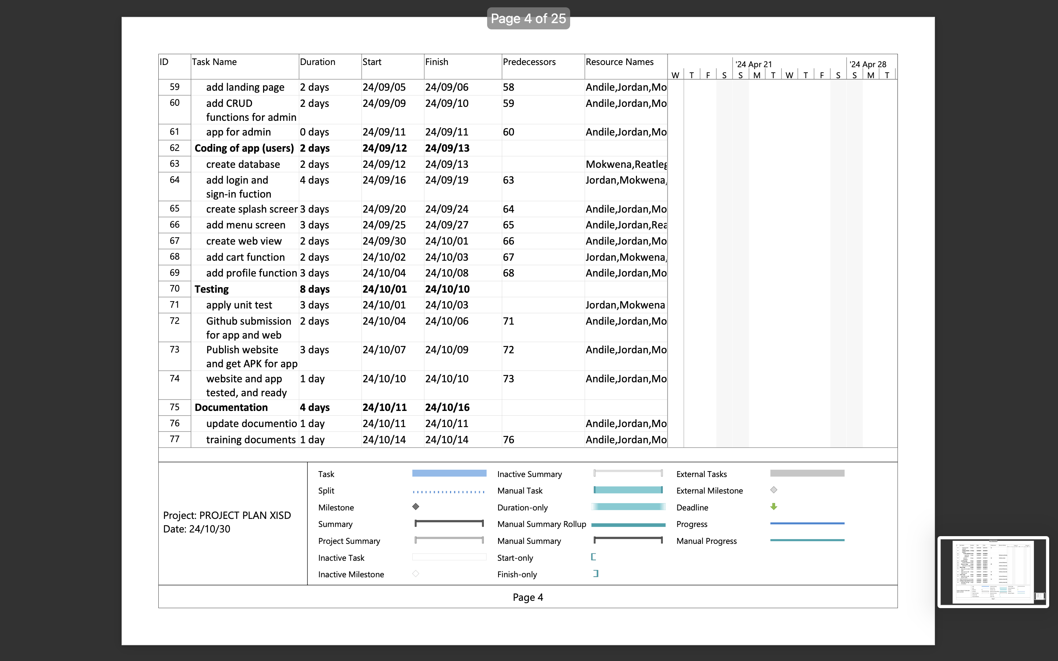
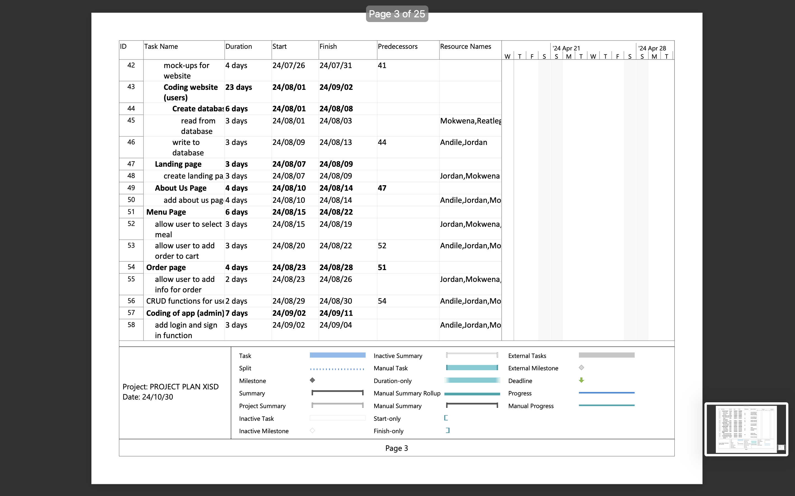

Slide 12
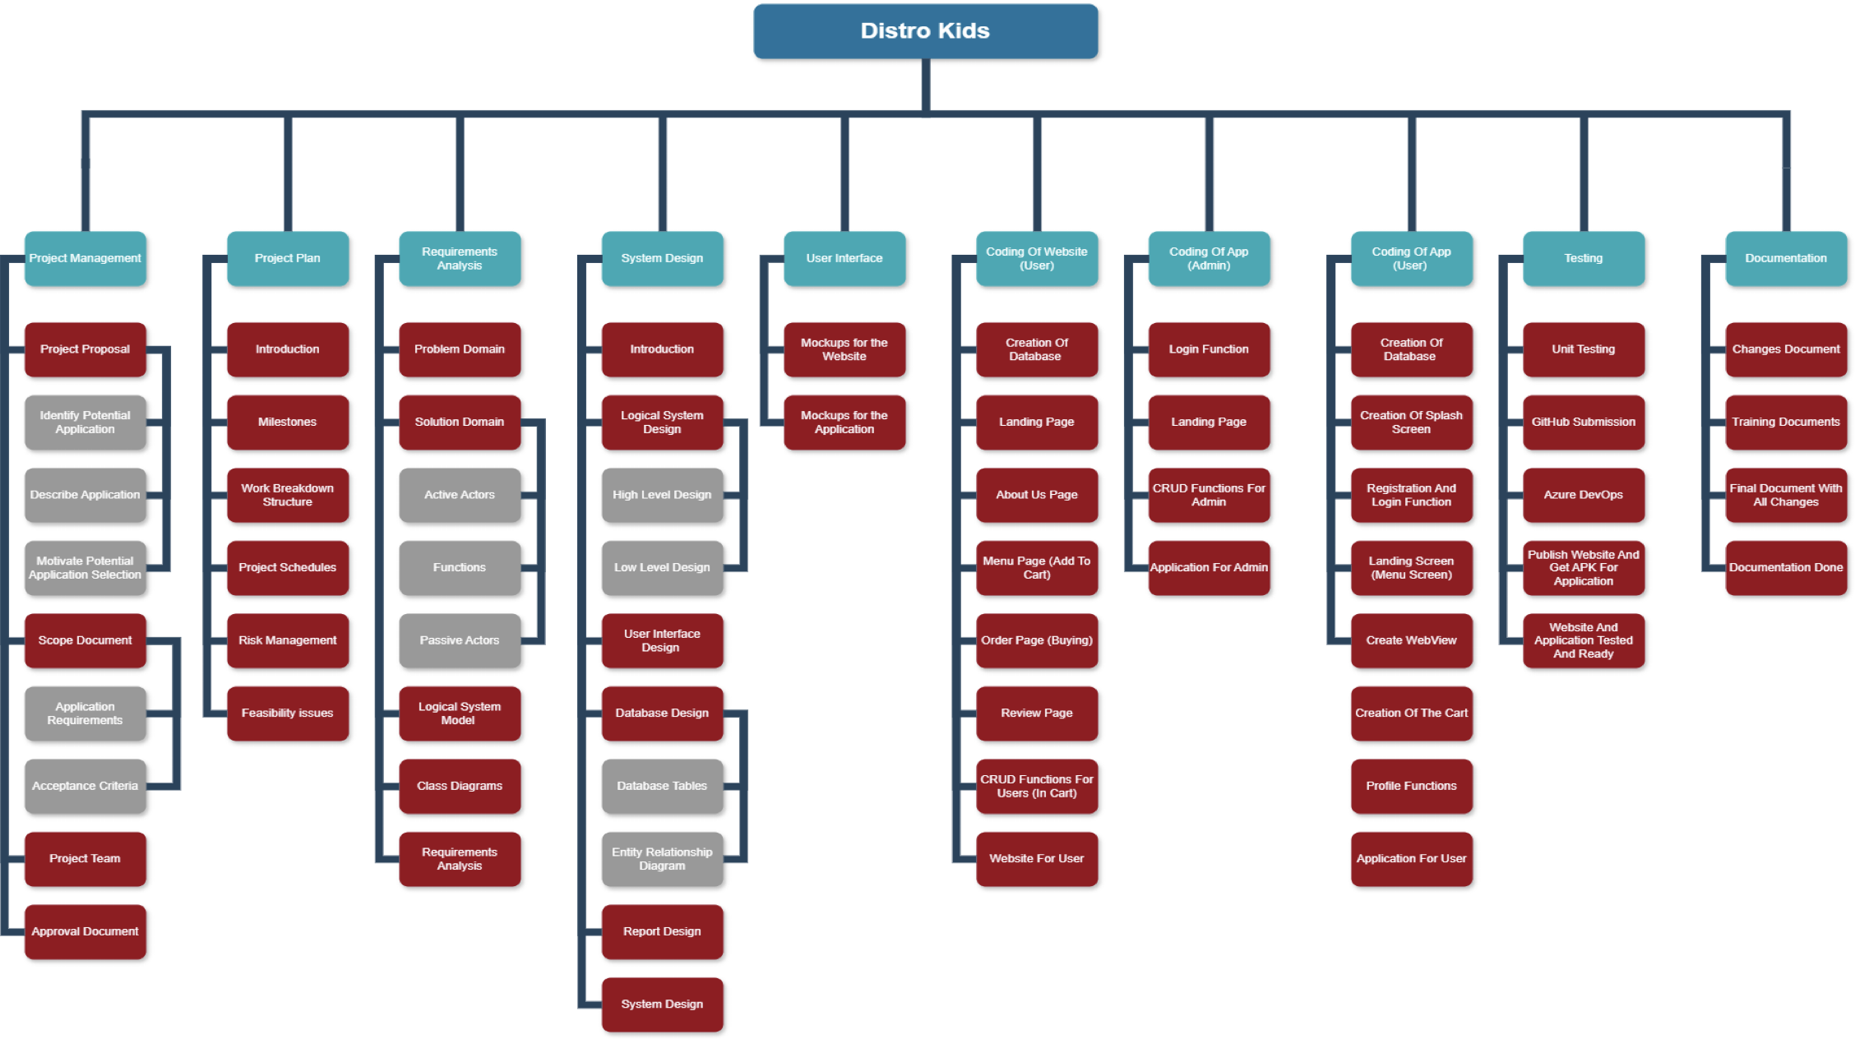

Slide 13

RISK MANAGEMENT

Slide 14
Risk | Impact | Likelihood of Occurrence | Degree Of Impact | Response Plan
Challenges with Integration | Lead to a clunky or inconsistent user interface, slow response times, and unreliable functionality. | Low | High | Choosing the right technology and partners
Team member absent | Missing of important communication | Low | Very Low | Send what was discussed through other channels
Absence of contact from the Sponsor | Approval Delays | High | Very High | Having communication at times through multiple channels
Schedule Delay | Work Delays | High | High | Conduct regular progress reviews
Vendor Onboarding and Support (business) | Service Quality Variability | Low | Medium | Provide a comprehensive welcome kit for the vendor that includes all necessary information
Food Vendor Reliability (business) | Customer Satisfaction | Medium | Medium | Hold regular meetings with vendors to review performance data
Team member absent | Missing of important communication | Low | Very Low | Send what was discussed through other channels
Absence of contact from the Sponsor | Approval Delays | High | Very High | Having communication at times through multiple channels
Changing User Preferences (business) | Decreased User Engagement | Medium | Medium | Regularly conduct surveys and collect feedback
Adoption Rate (business) | Brand Perception | Medium | High | Develop compelling launch campaigns
"Competition
(business)" | Increased Marketing Costs | Low | High | Develop and highlight unique offerings
Regulation Compliance (business) | Market Access Restrictions | Low | Low | Engage with legal experts specialising in food

Slide 15

TECHNICAL FEASIBILITY ISSUES

Slide 16
Hardware Resources
Computers or laptops: These are necessary to run the development environment and code.
Availability: The availability in the team is high in terms of all the hardware devices needed as everyone within our company has access to their own devices in terms of the computers/laptops.
Solution: If not available, the team can either rent out laptops/computers or they can do all of this on campus where there is all you need there.
2. Smartphones or tablets: To test the mobile application across various hardware configurations and screen dimensions.
Availability: The availability in the team is high in terms of all the hardware devices needed as everyone within our company has access to their own devices in terms of the smartphones/tablets.
Solution: If not available, the team can rent some out for certain periods of time whenever necessary.
3. Internet Connection: In order to deploy the application and access online resources and repositories, a steady internet connection is required.
Availability: Internet Connection availability is very high as this is available in the respective households. The only time that the availability is low is when there are outages or long periods of loadshedding.
Solution: If not available, you can have group meetings or get togethers at internet cafes or try mobile data plans to work around this.

Slide 17
Software Resources
Database Management Systems (DBMS): We'll utilize MySQL, SQLite, or FireBase to store and manage data.
Availability of a DBMS that satisfies the data needs of the application.
Solution: If not available, the team can then just install a DBMS on our devices.
2. Version Control Systems (VCS): To manage code changes and work together with all of the group's junior developers.
Availability: Access to tools like Git are crucial.
Solution: If not available, the team would make use of an online platform such as GitHub which we are familiar with.
3. Tools for Development: These comprise Integrated Development Environments (IDEs) such as Visual Studio for C#, Android Studio for Java and Kotlin.
Availability: It is very accessible to us as the school provides us with these resources on our school website which leads to a very high availability.
Solution: If not available, the team can just download them off the school’s website where it is available for free.
4. Regarding automated testing and quality control.
Availability: Tools like JUnit for Kotlin and Java and NUnit for C#.
Solution: If not available, the team can make use of online platforms that perform testing frameworks.

Slide 18
Software Resources
6. System Testing skills and platforms : Visual Studio Unit Testing​
7. Deployment Tools and know-how : Azure DevOps and GitHub

Slide 19

BUDGET

Slide 20
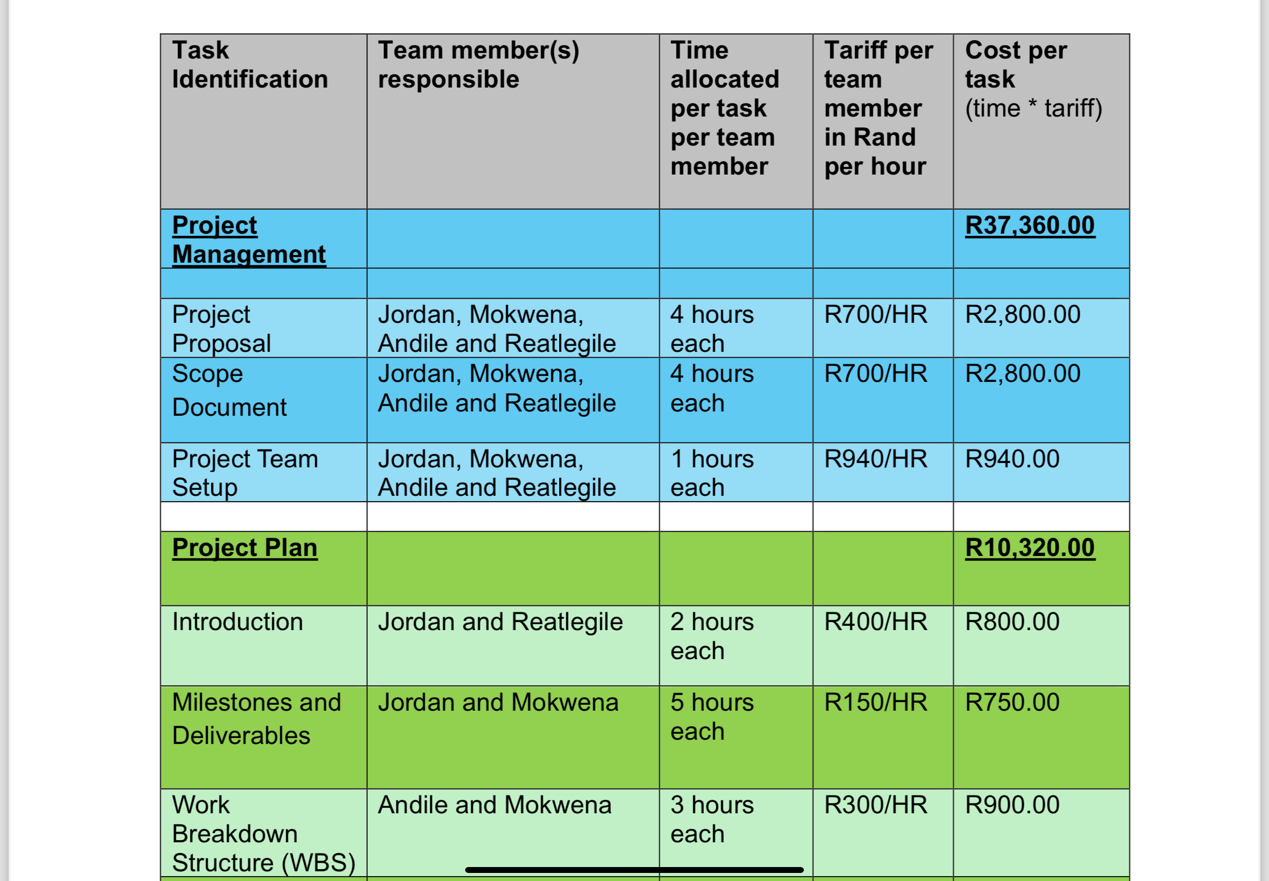

Slide 21
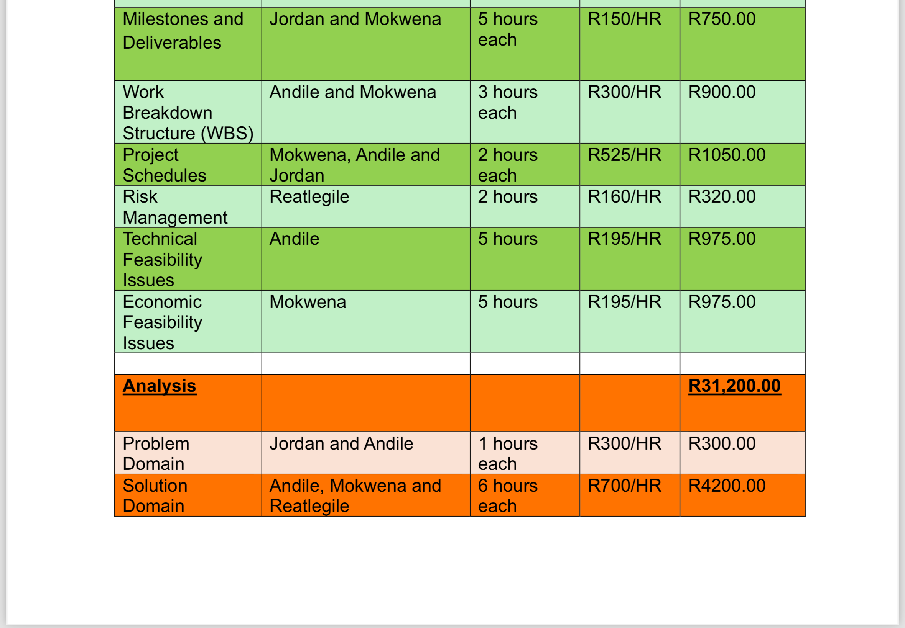

Slide 22
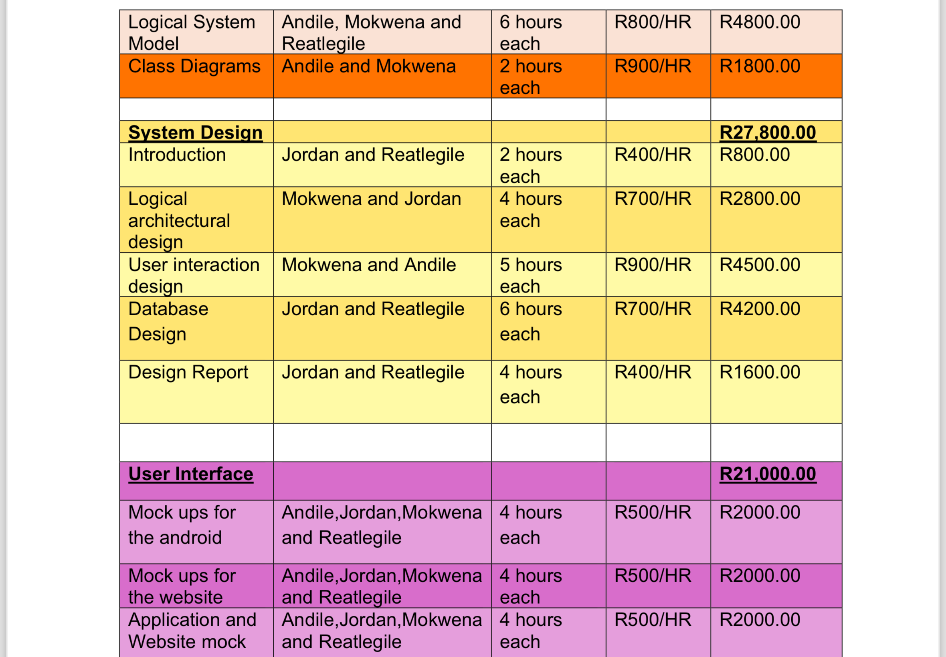

Slide 23
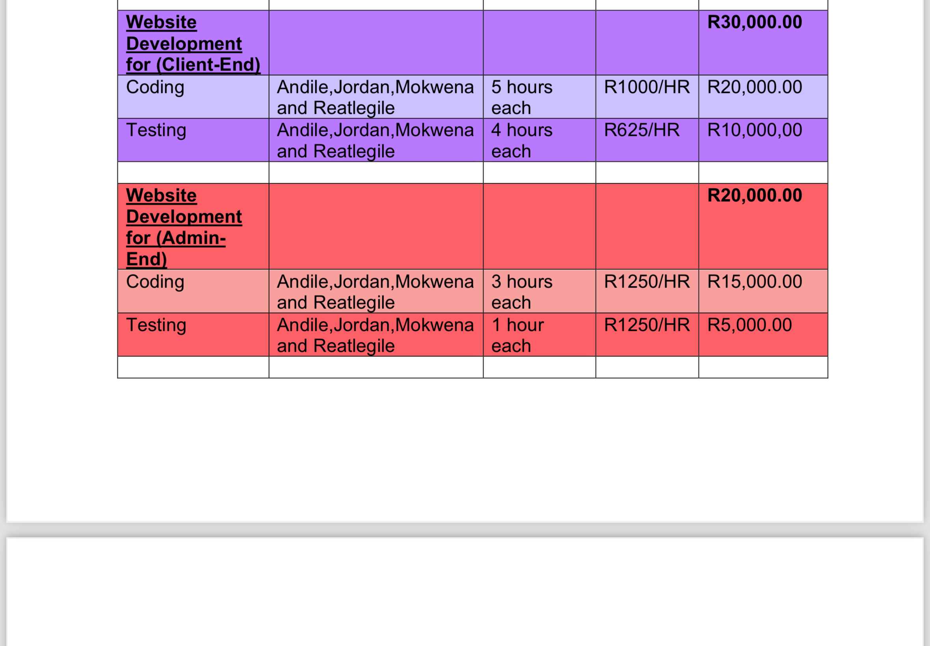

Slide 24
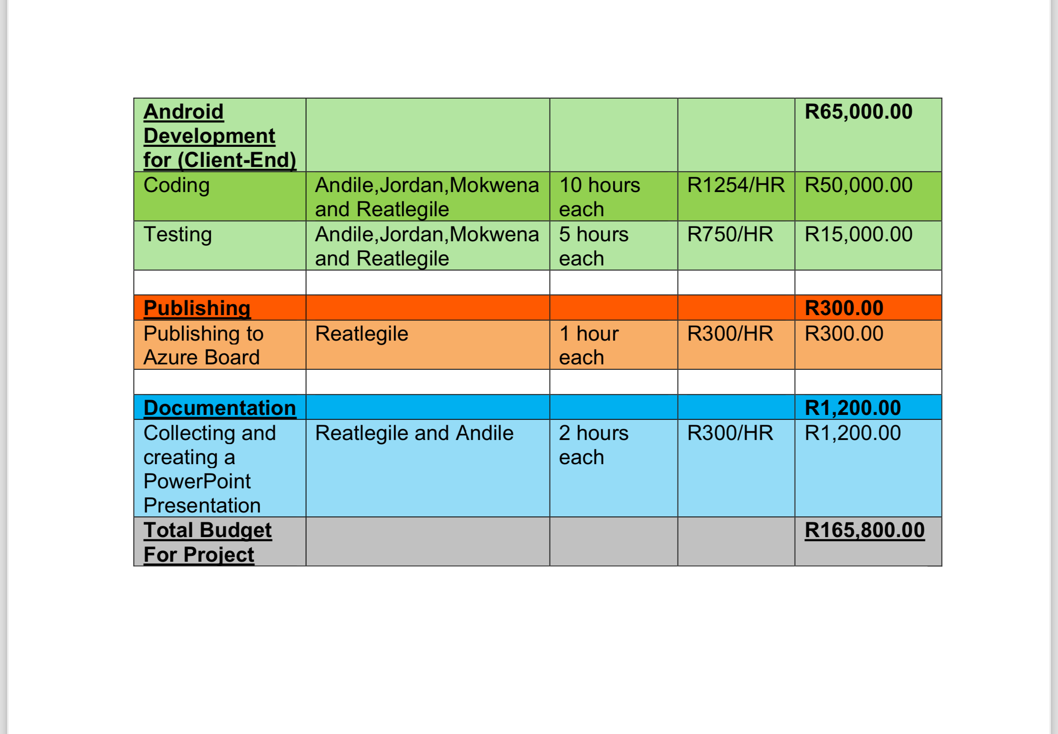

Slide 25

LOGICAL ARCHITECTURAL DESIGNS
Our architectural design provides an over view of the application's functionalities and their interactions. This is
followed by detailed descriptions of the specific functions available to both users and administrators. We have
included mock GUI representations for both the website and the mobile application to illustrate these
interactions. Additionally, the database tables and Entity-Relationship Diagram (ERD) present a detailed layout of
the necessary fields and data structures to support the application's operations.

Slide 26
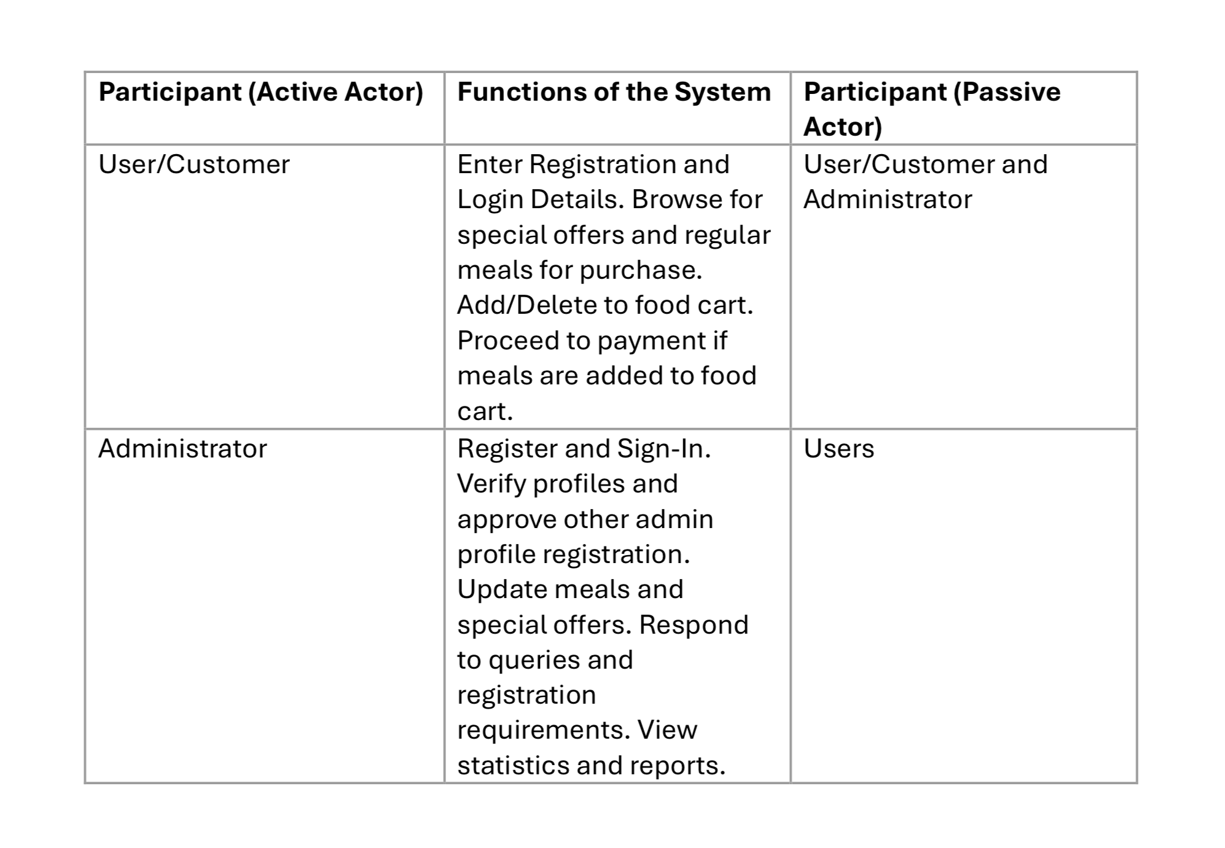
WEBSITE SOLUTION DOMAIN

Slide 27
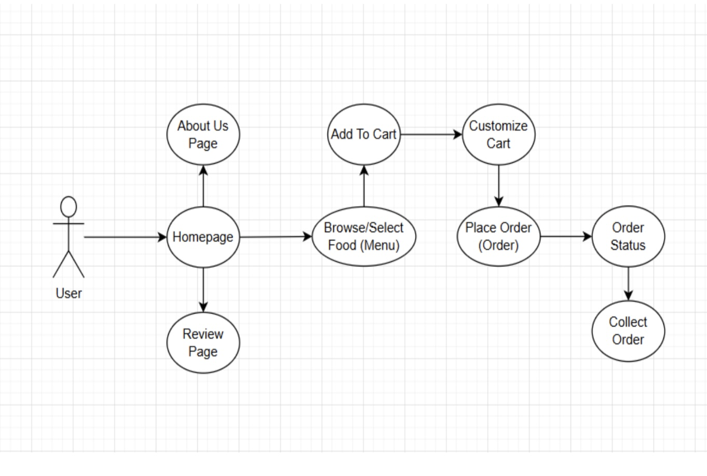
WEBSITE USE CASE DIAGRAM

Slide 28
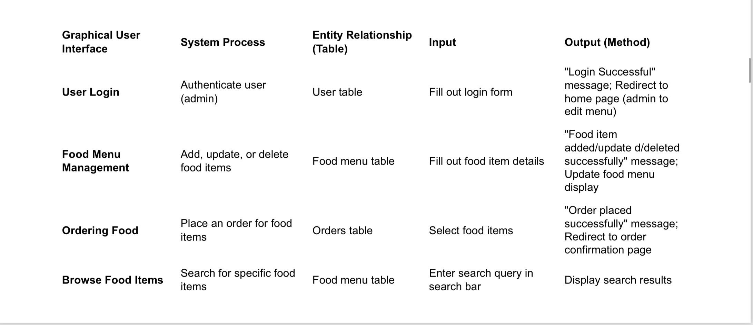
WEBSITE LOGICAL SYSTEM MODEL

Slide 29
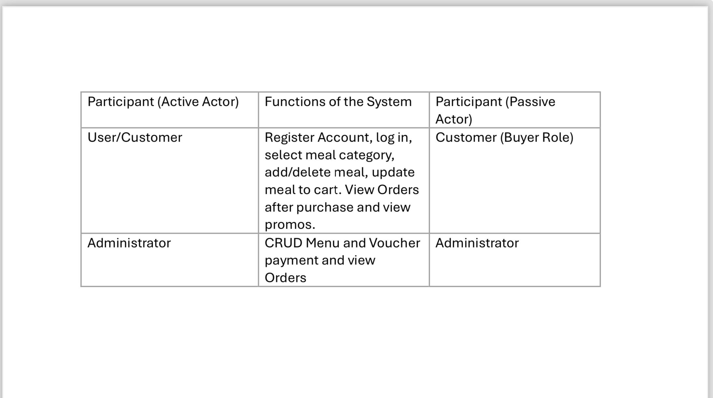
APPLICATION SOLUTION DOMAIN

Slide 30
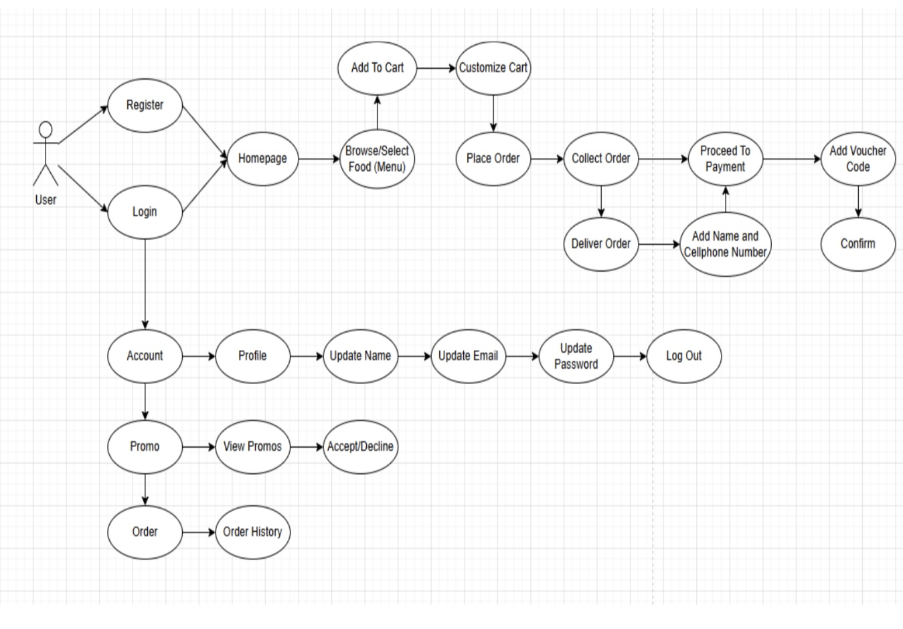
APPLICATION USE CASE DIAGRAM

Slide 31
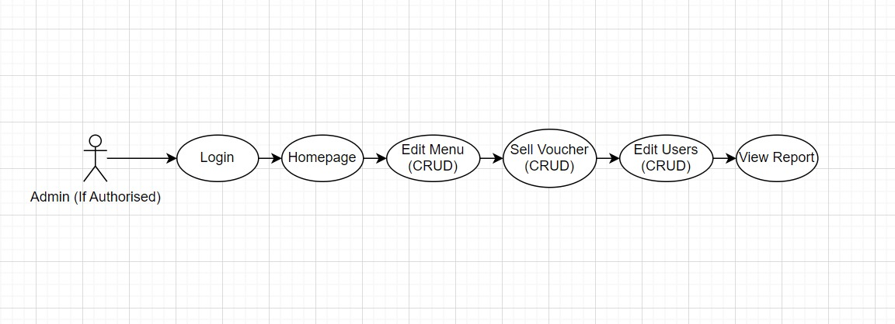
APPLICATION USE CASE DIAGRAM (ADMIN)

Slide 32
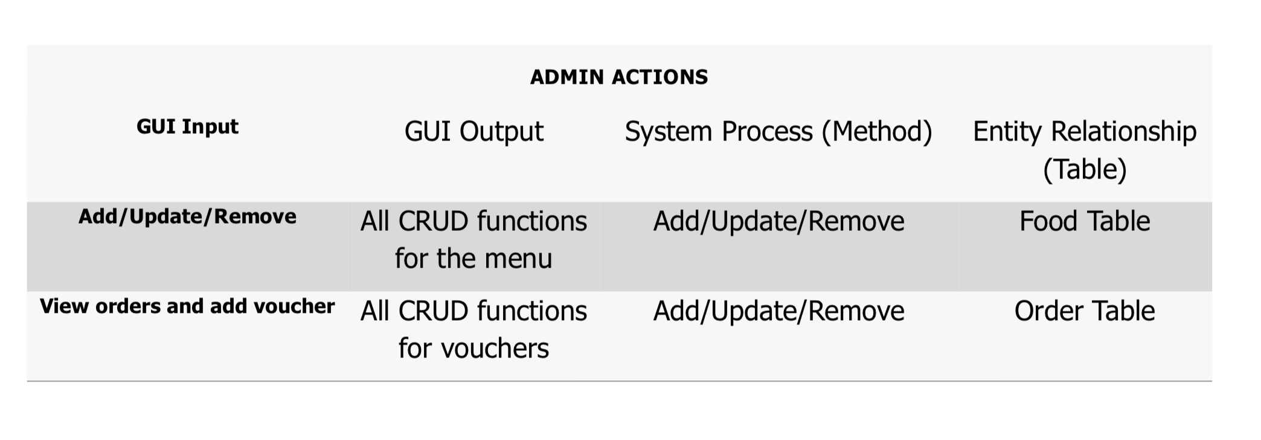
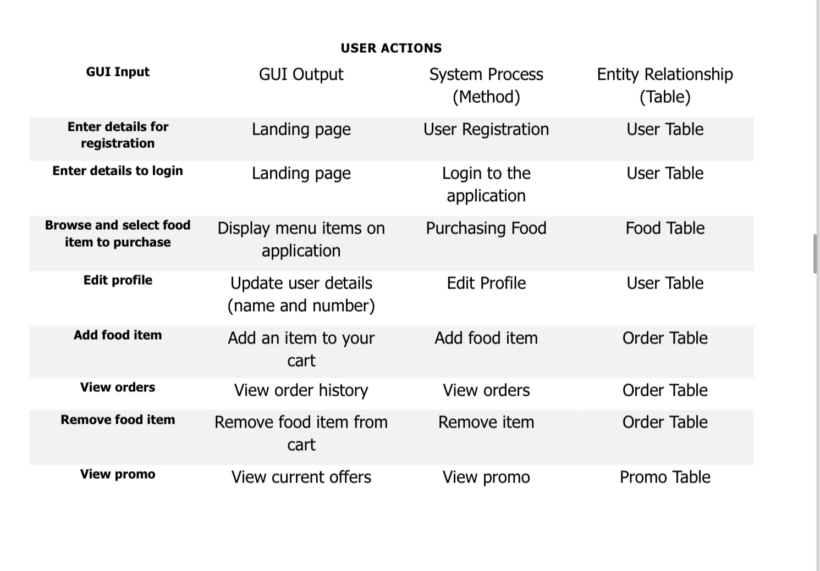
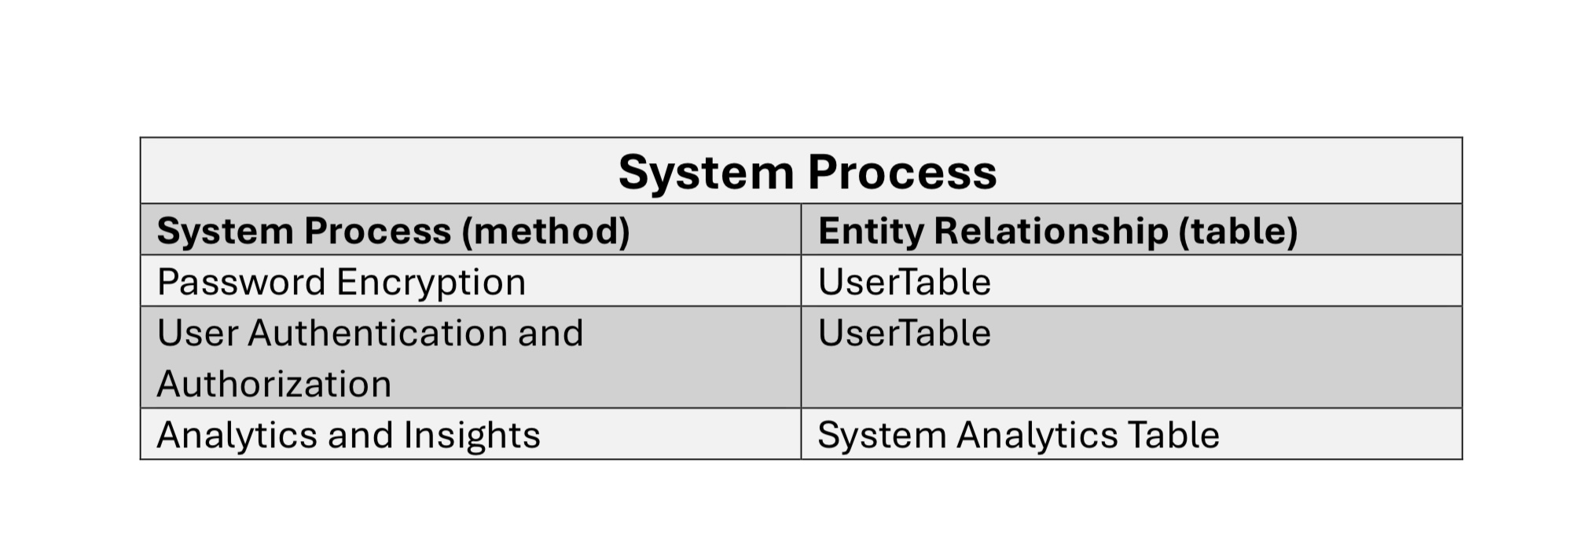
APPLICATION LOGICAL SYSTEM MODEL

Slide 33
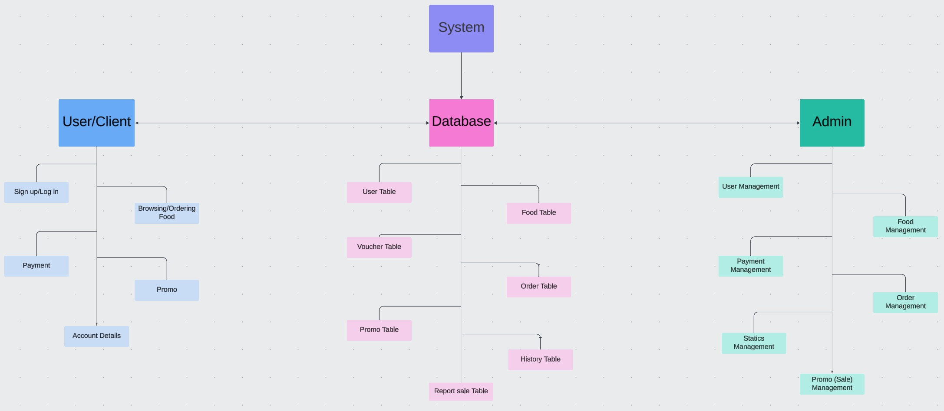
ACHITECTURAL DESIGN "HIGH-END"

Slide 34
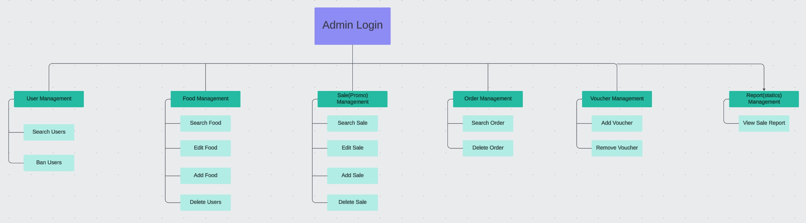
ADMINISTRATOR "MANAGER"

Slide 35
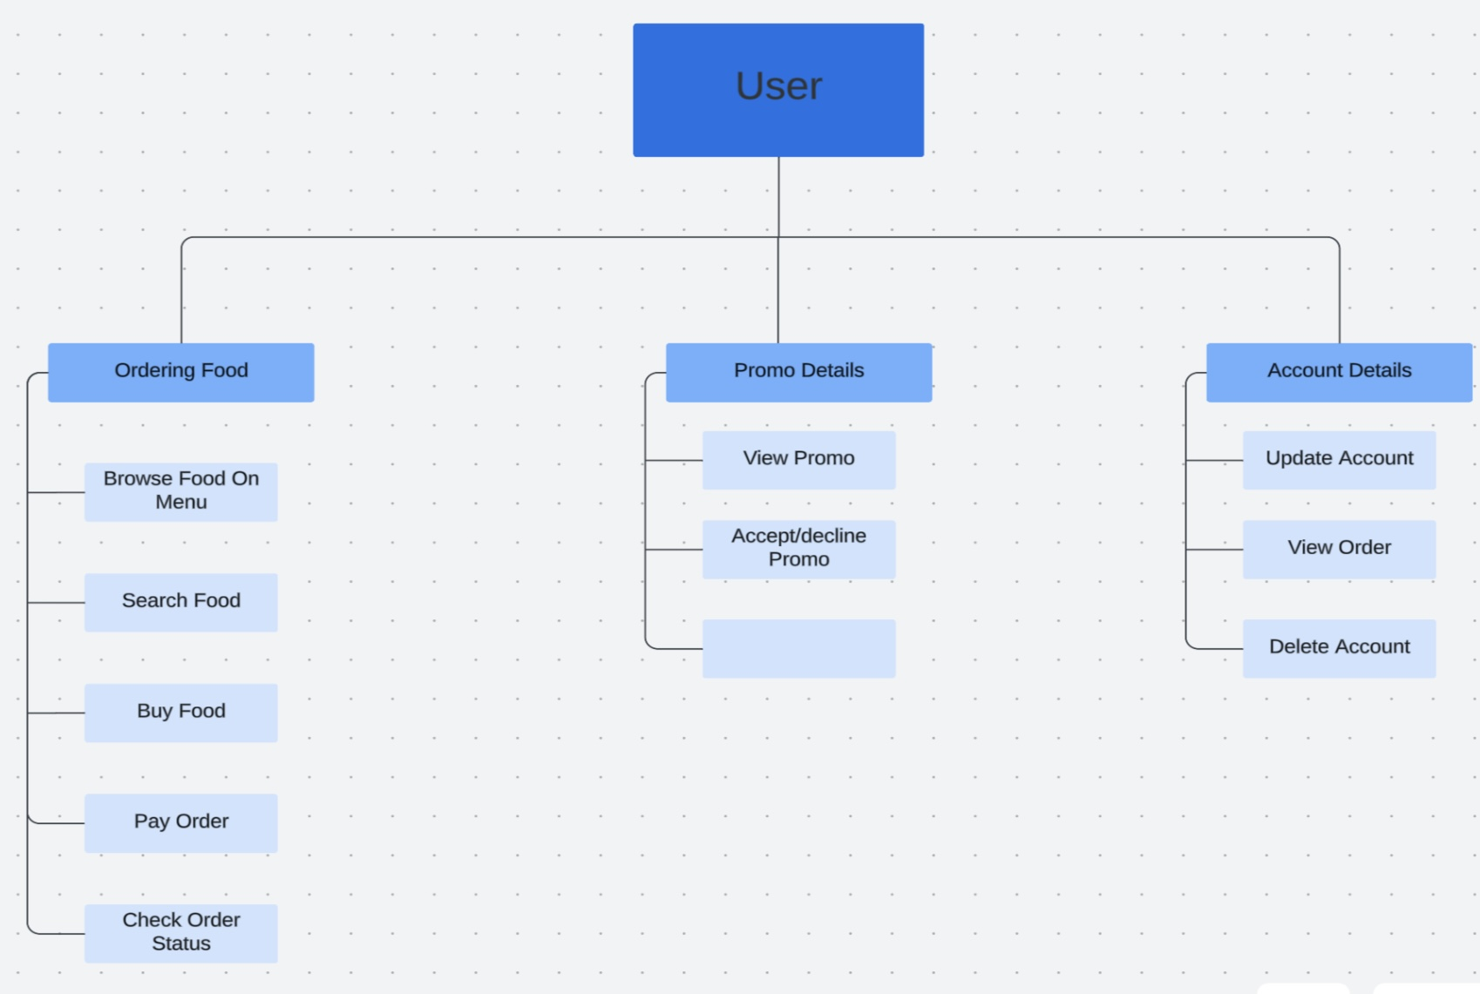
USER "CLIENT"

Slide 36
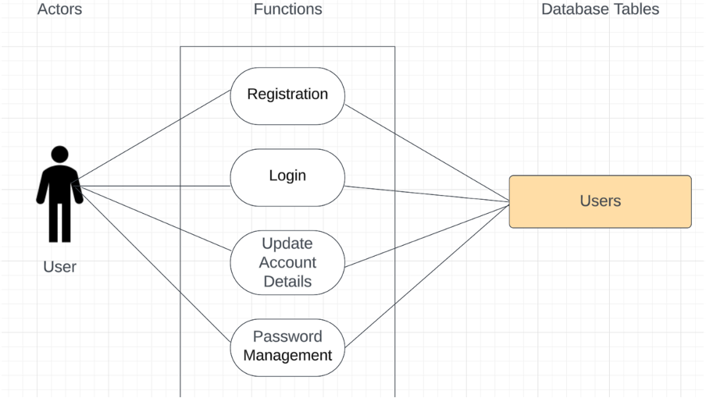
ARCHITECTURAL DESIGN "LOW-LEVEL"

Slide 37
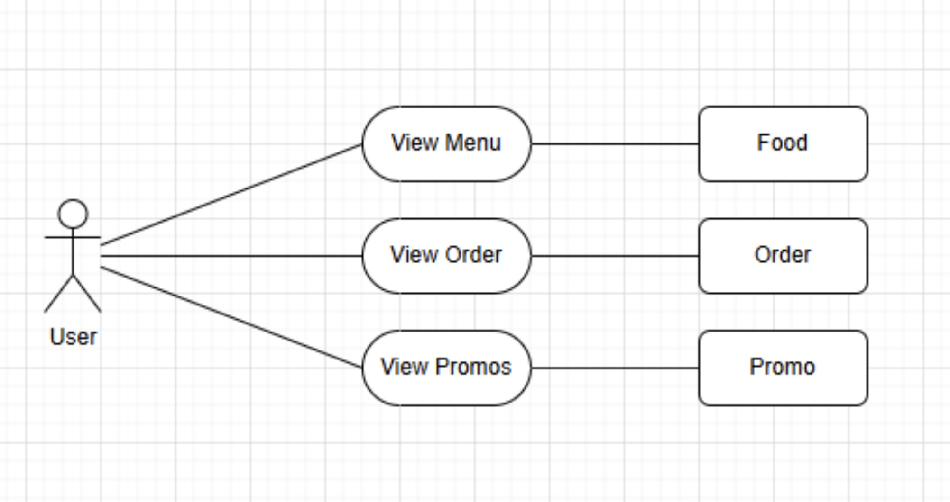

Slide 38
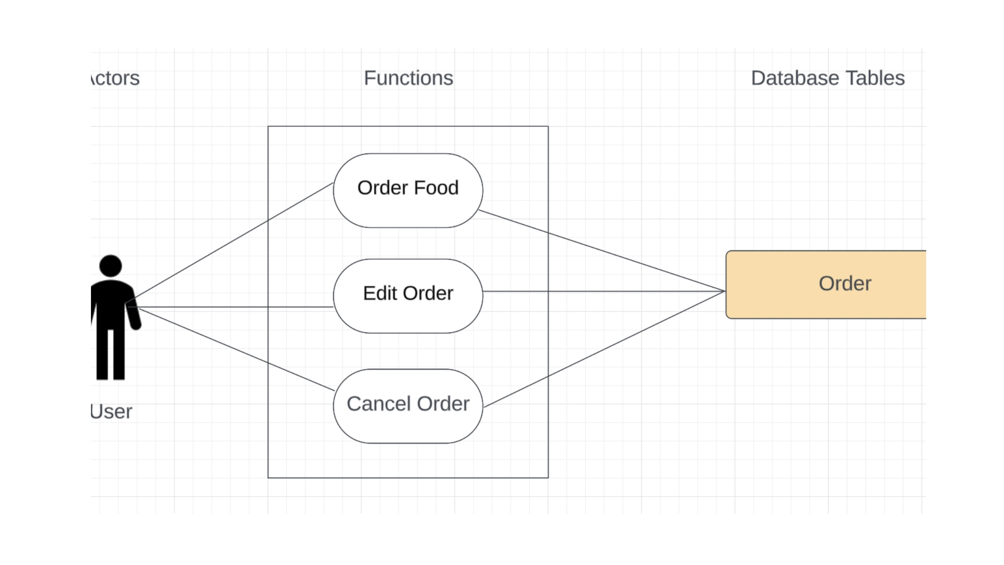

Slide 39
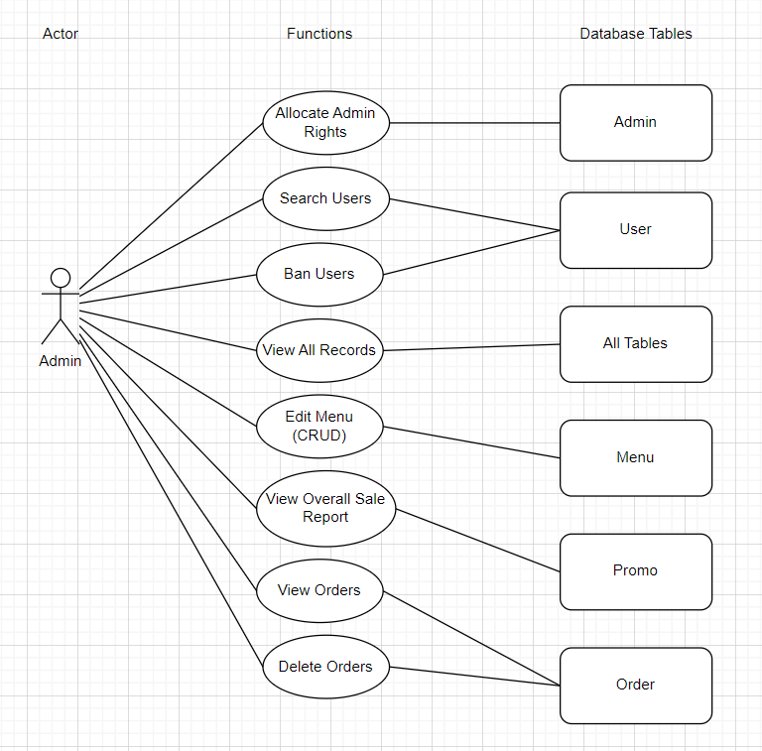

Slide 40

USER INTERACTIONS "DESIGN WEBSITE"

Slide 41
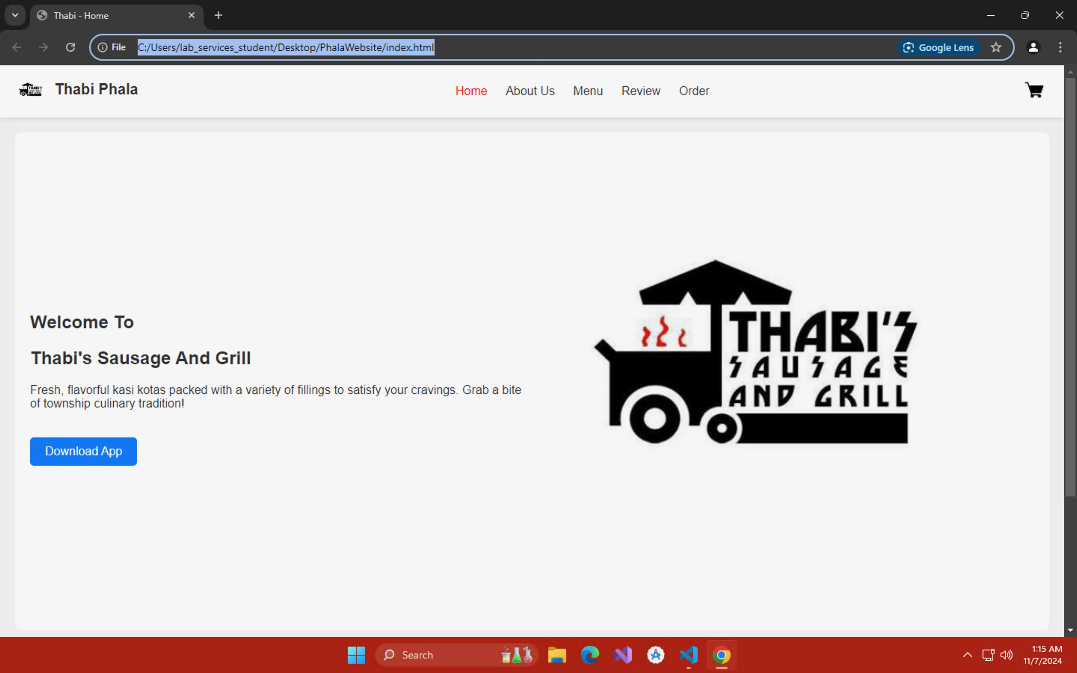

Slide 42
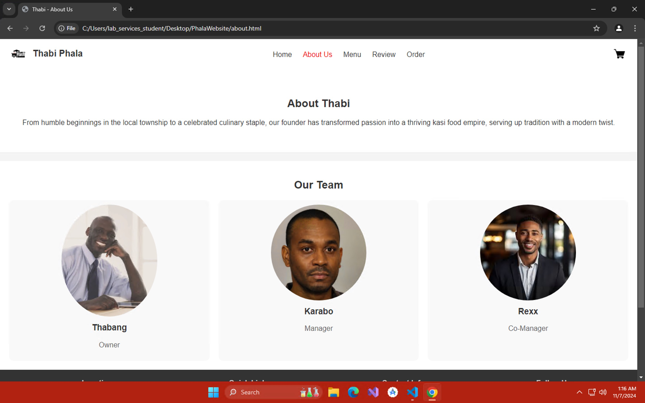

Slide 43
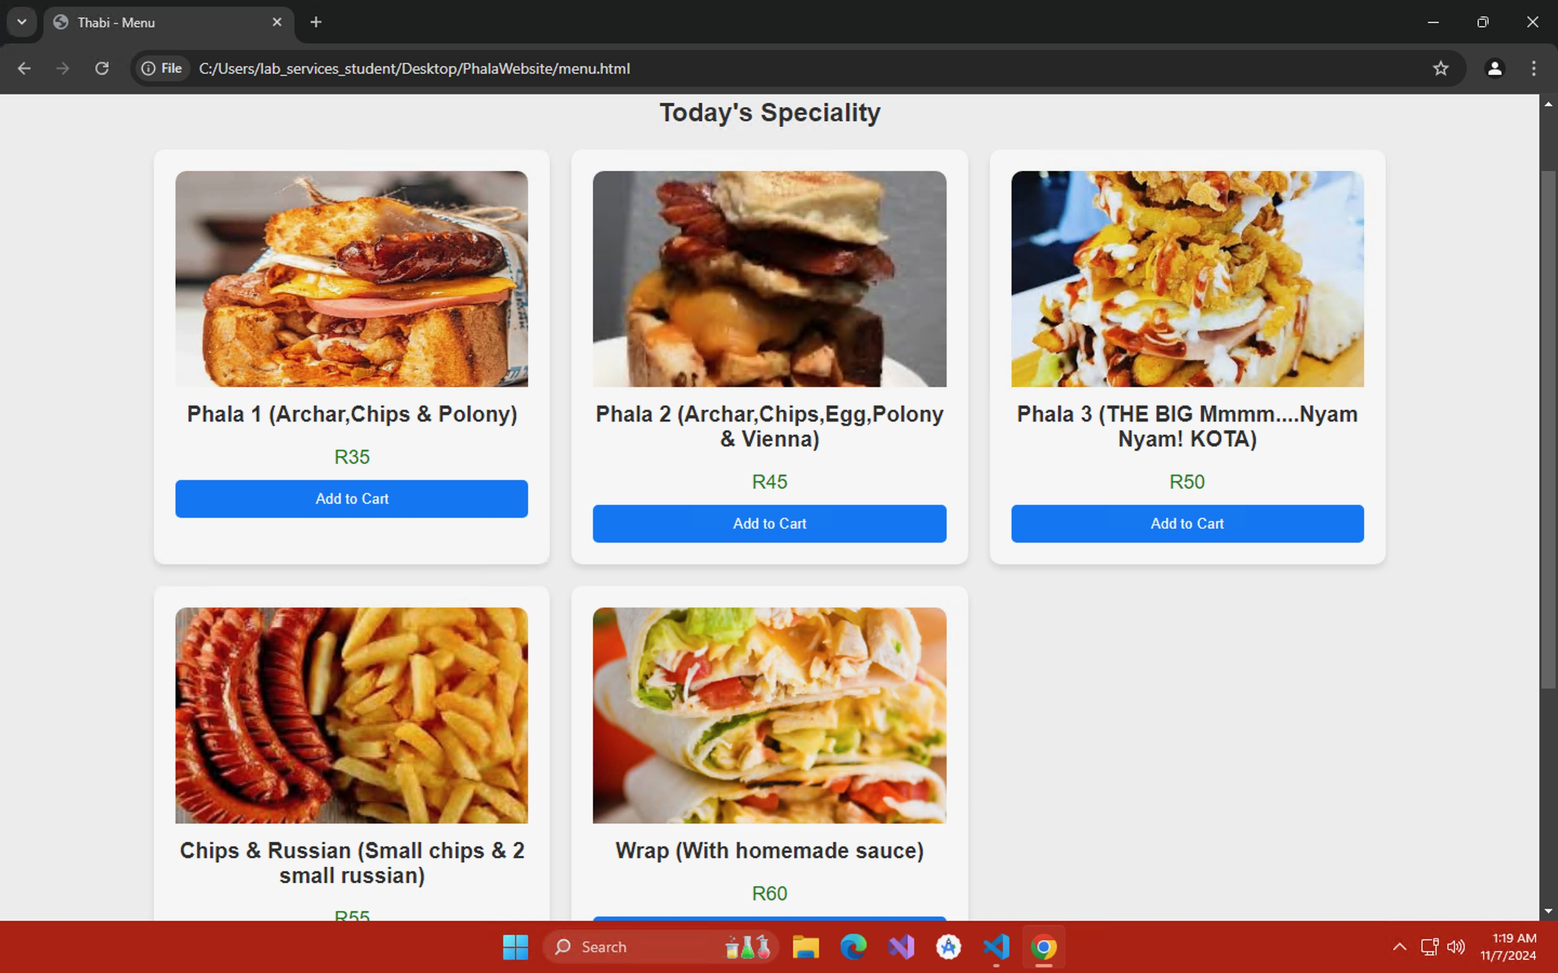

Slide 44
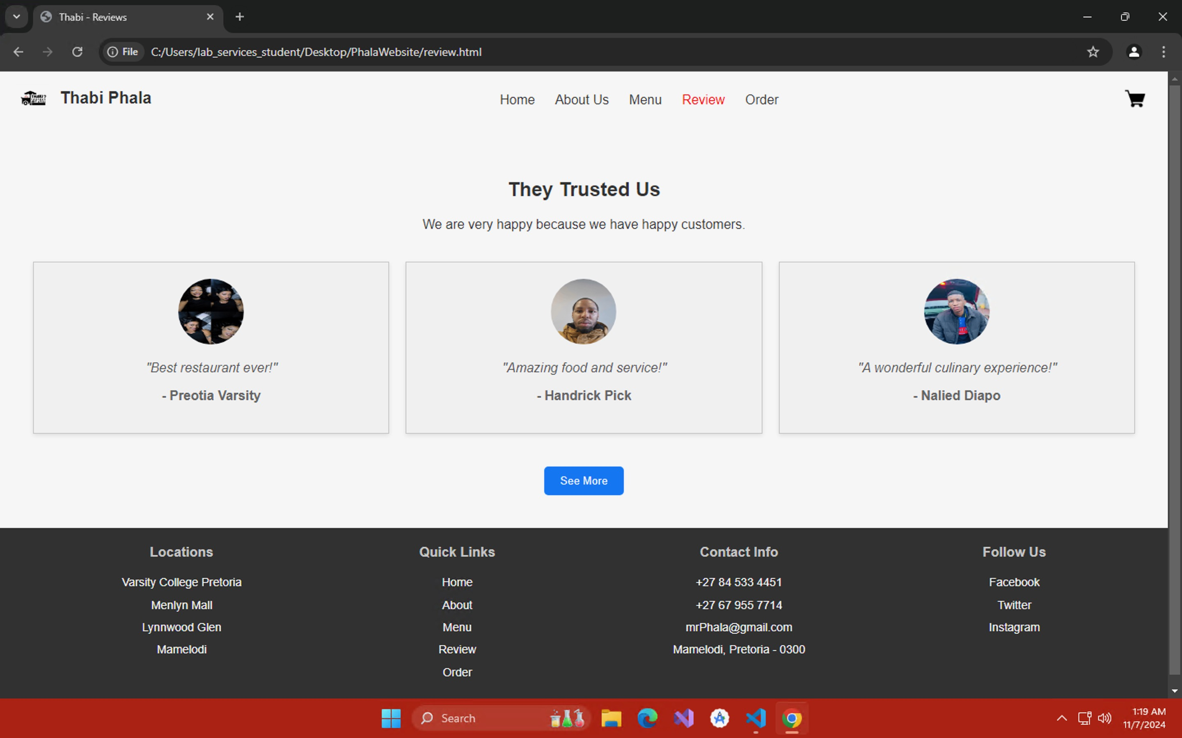

Slide 45
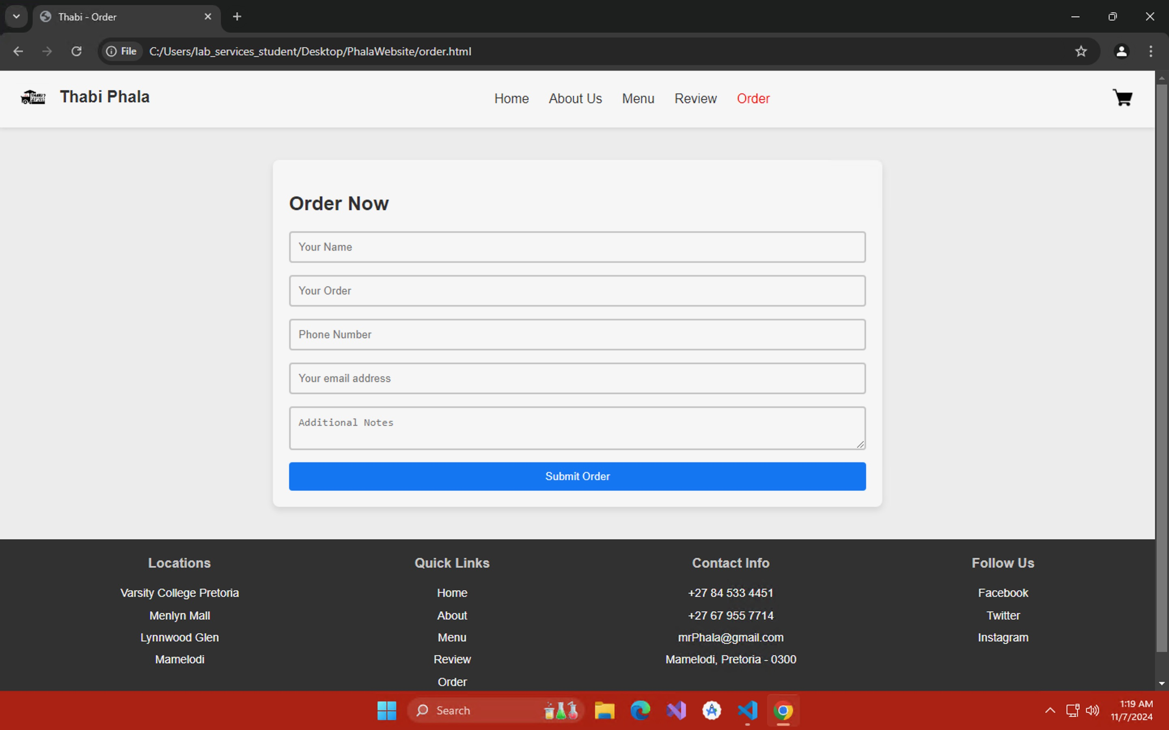

Slide 46

USER INTERACTIONS "DESIGN APP"

Slide 47
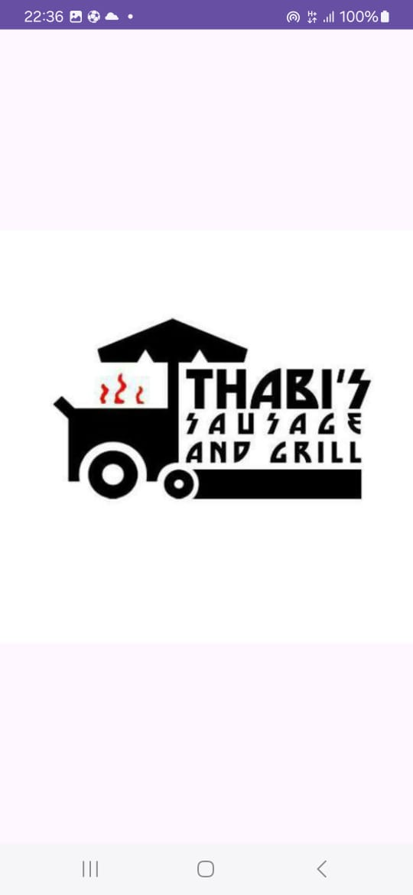
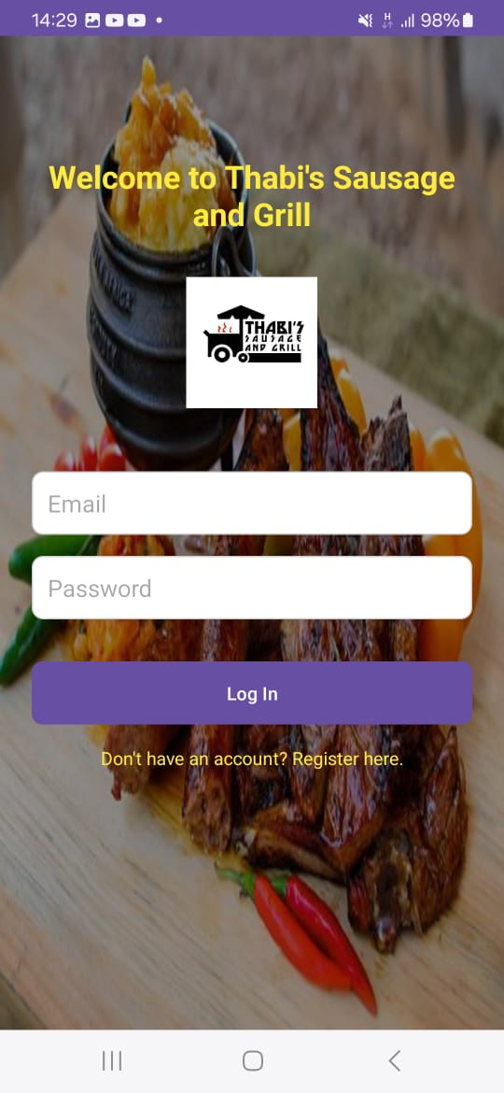
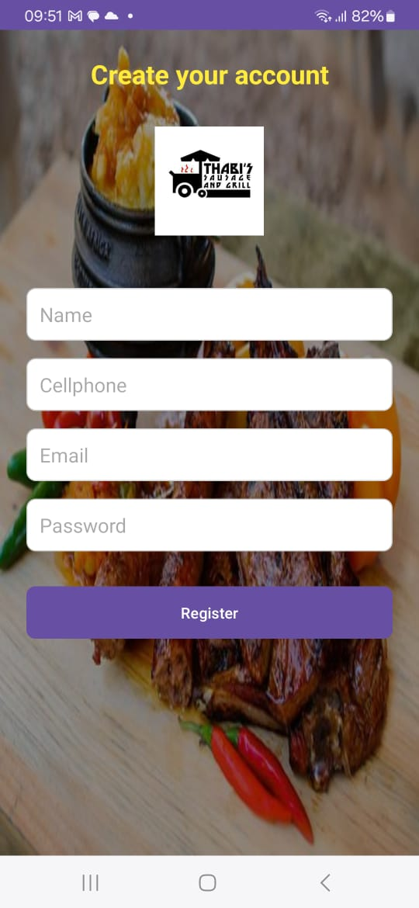
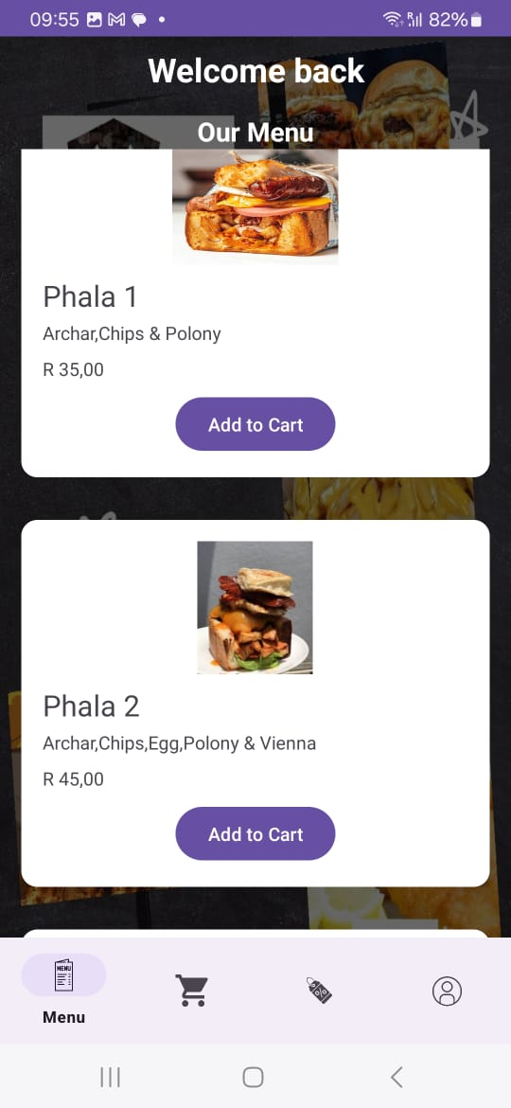

Slide 48
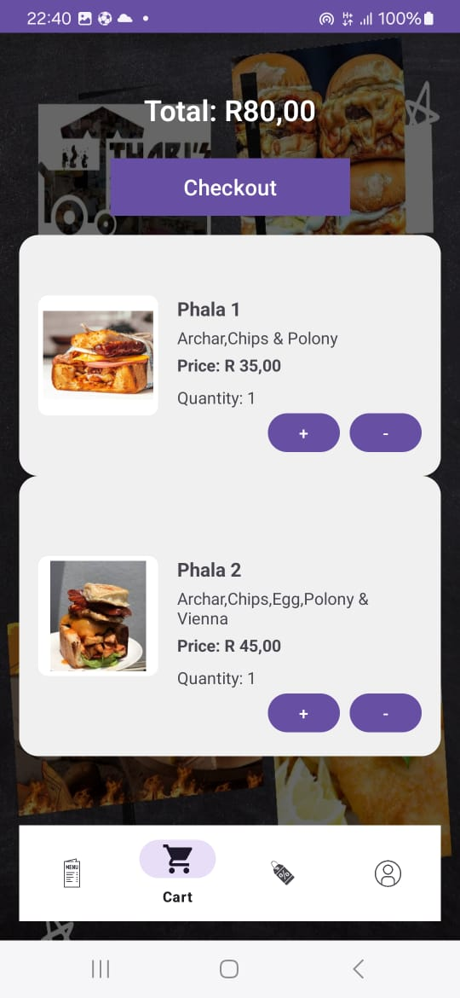
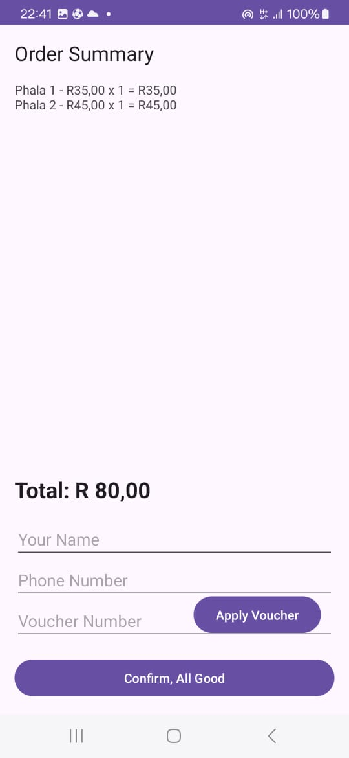

Slide 49
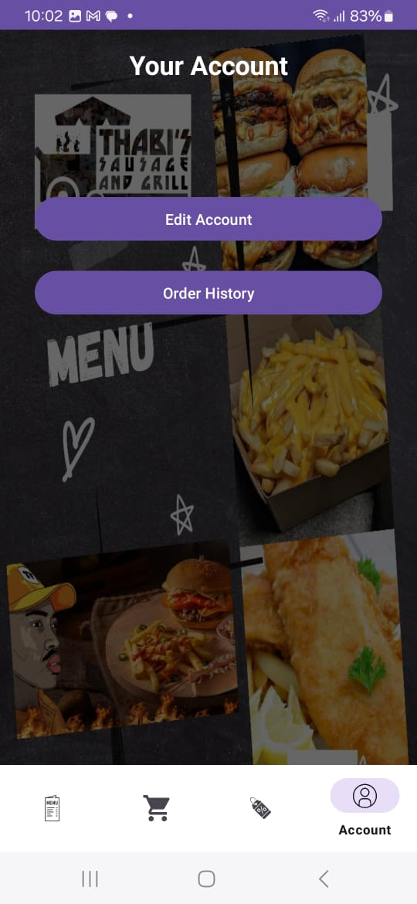
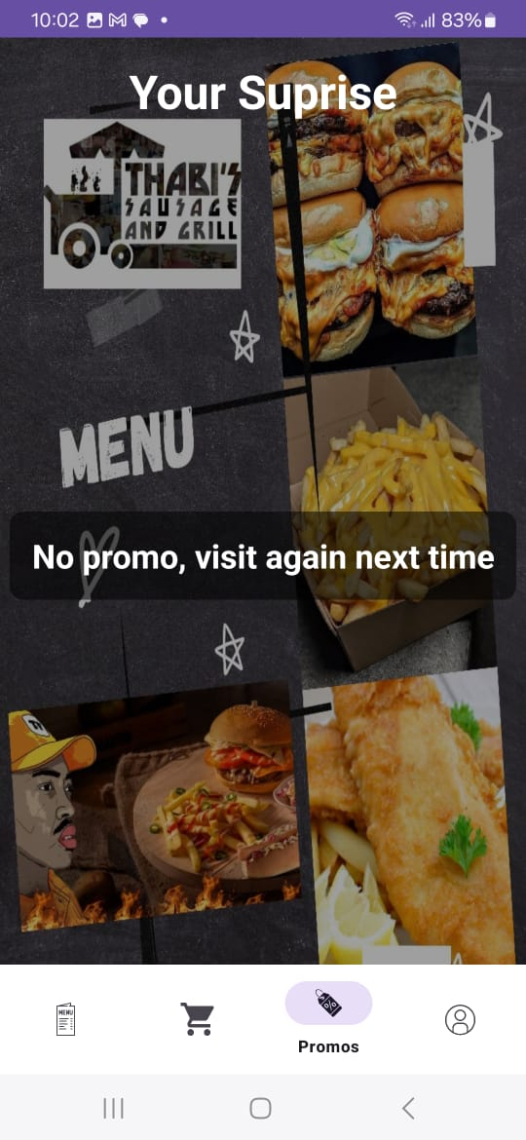
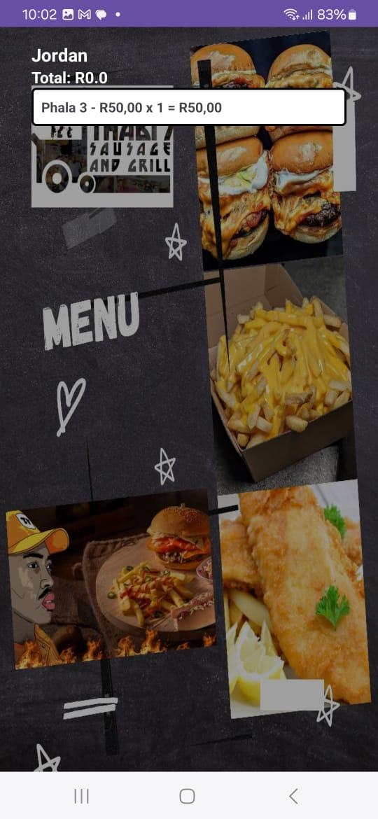

Slide 50

ADMIN INTERACTIONS

Slide 51
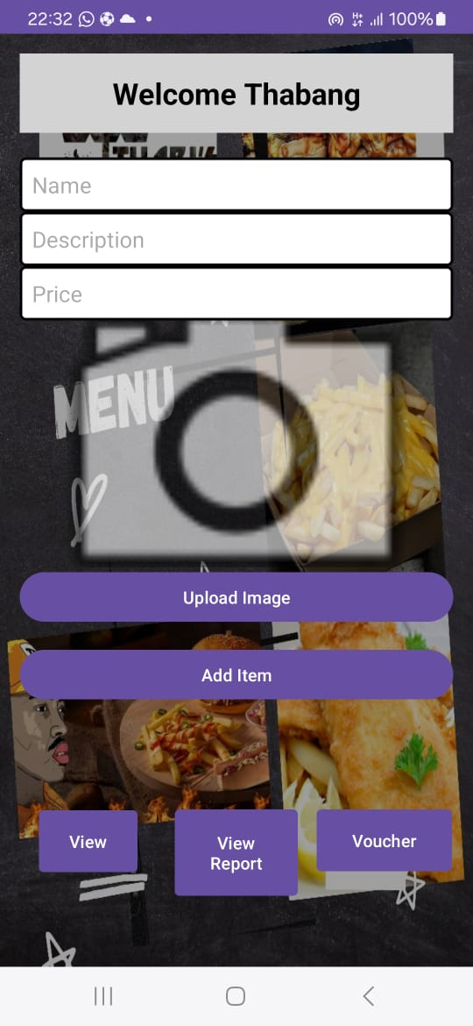
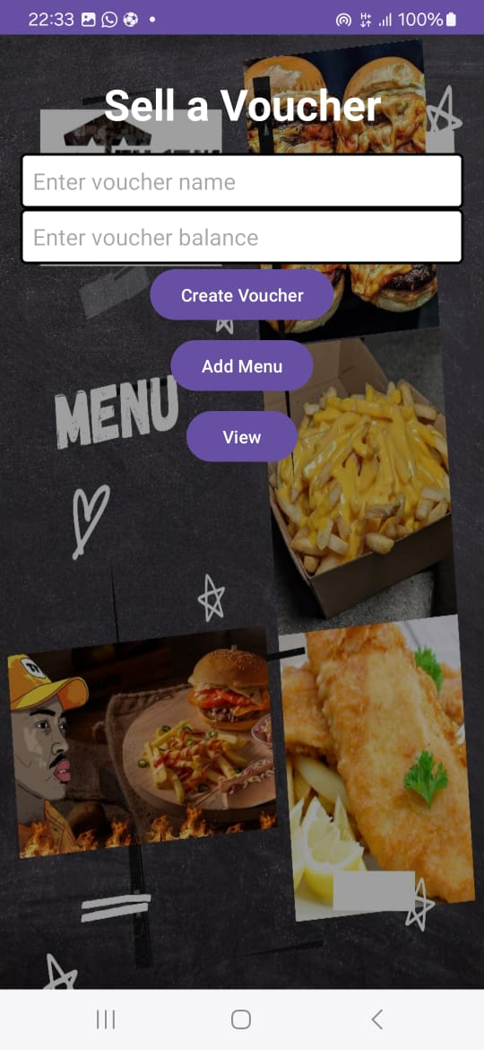
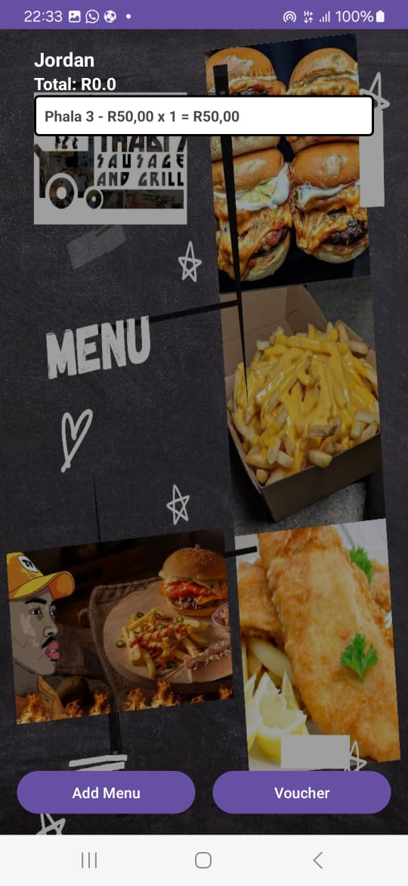

Slide 52

DATABASE DESIGN

Slide 53
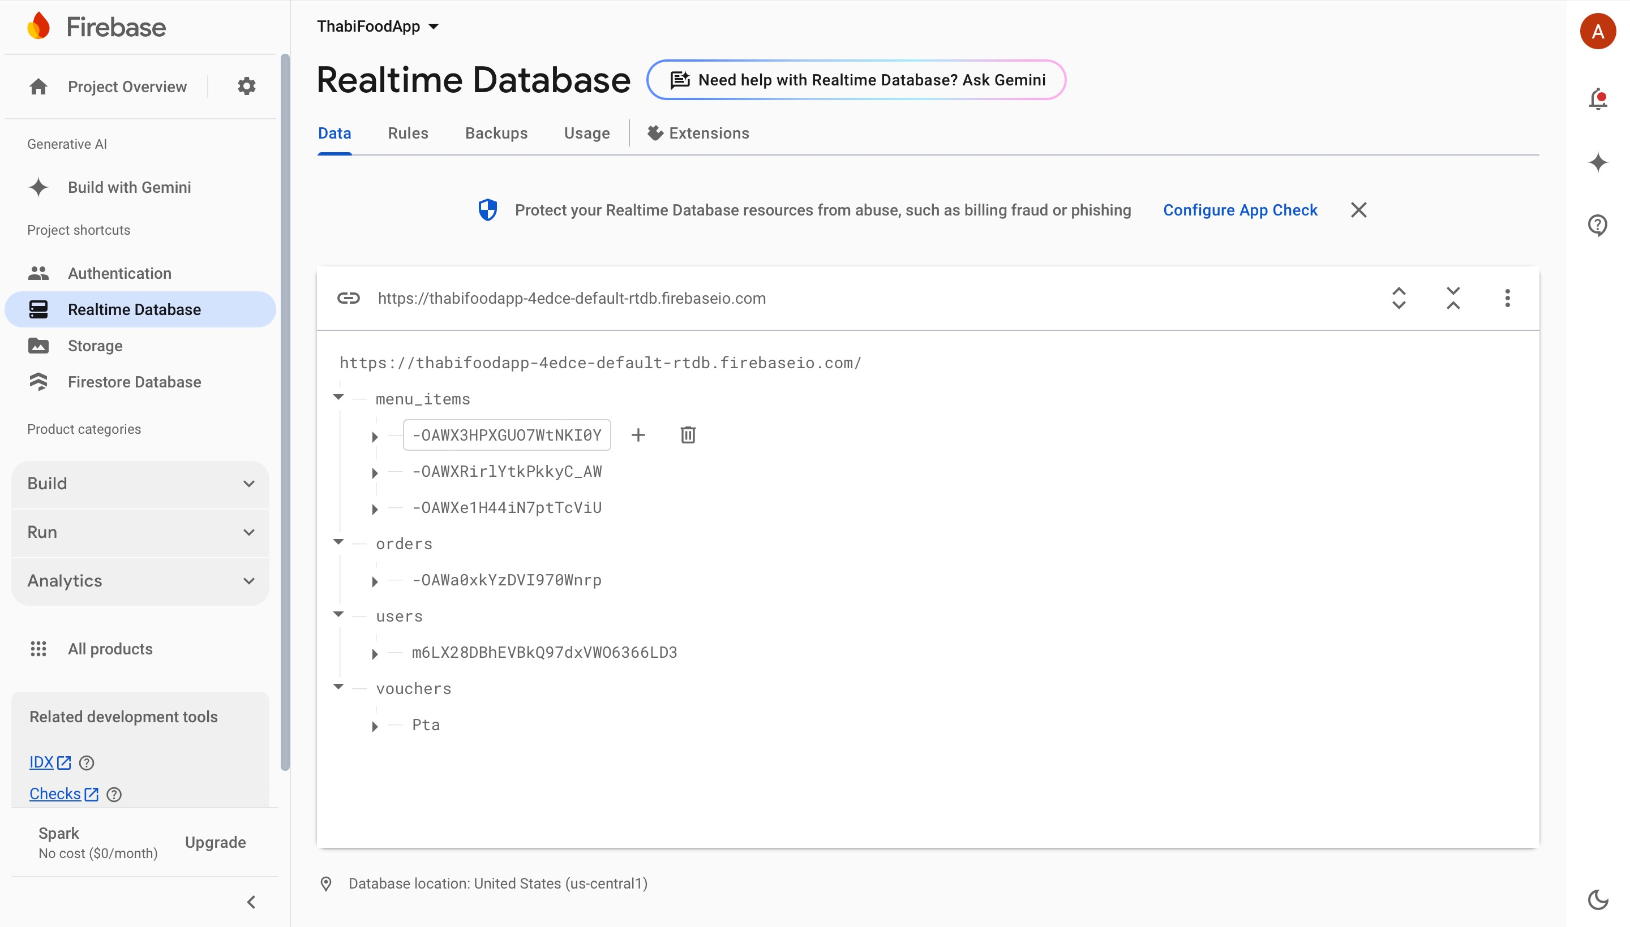

Slide 54
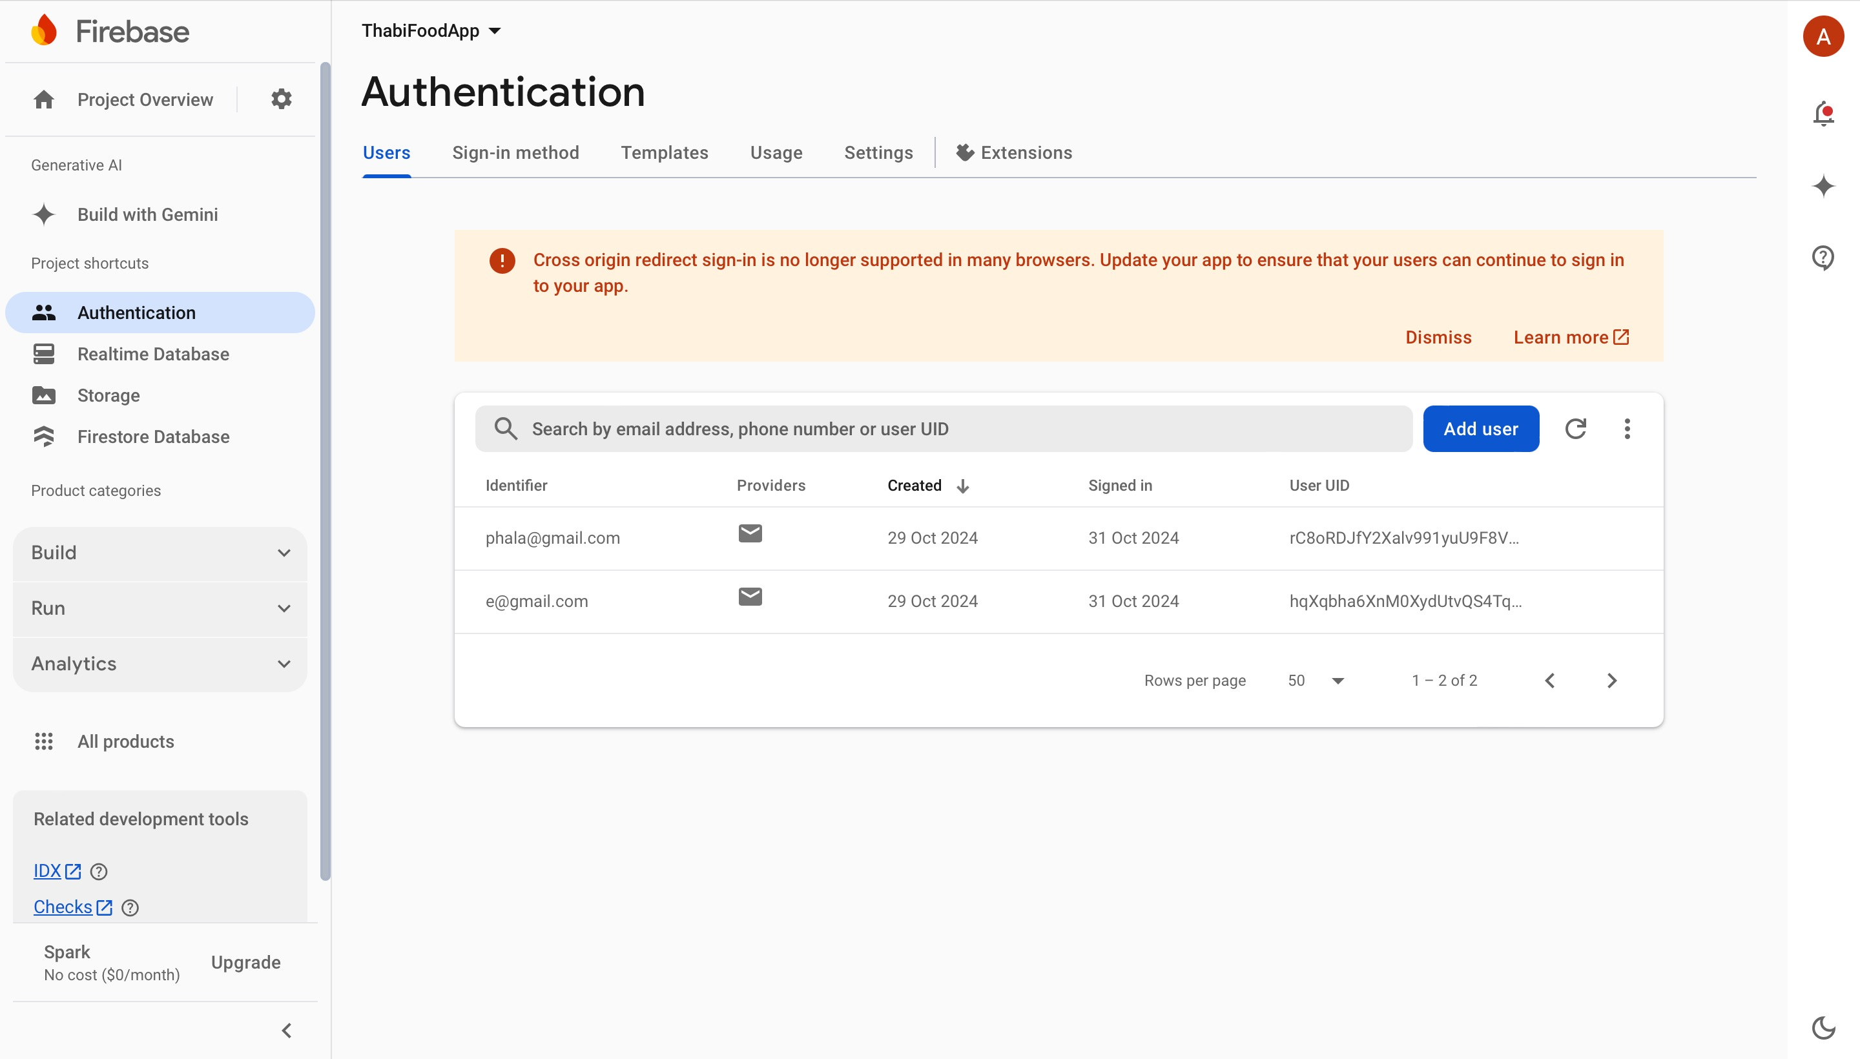

Slide 55


